Slide 1
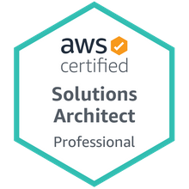
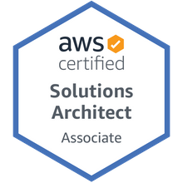
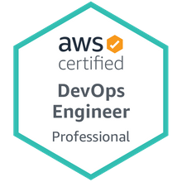

AWS – Elastic Kubernetes Service (Amazon EKS) – Hands-on guide/ POC/ Case Study/ Use Case.
Mr. Subramanyam Tirumani Vemala
https://www.linkedin.com/in/subbulinkedin/

Slide 2
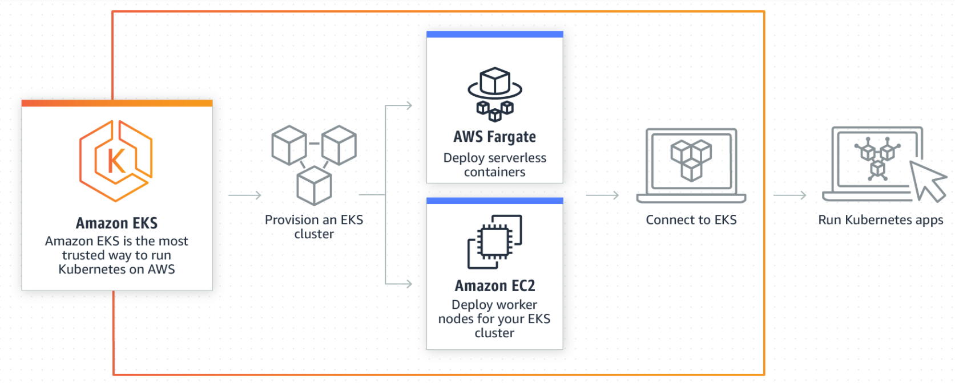
EKS Architecture - Component diagram: In this POC, TypeB (Amazon EC2’s) is used, as we need to go for Cloud agnostic Architecture. a. Fargate – creates the serverless containers. b. Amazon EC2’s – Deploy the Worker nodes and map to the EKS Cluster.

Slide 3
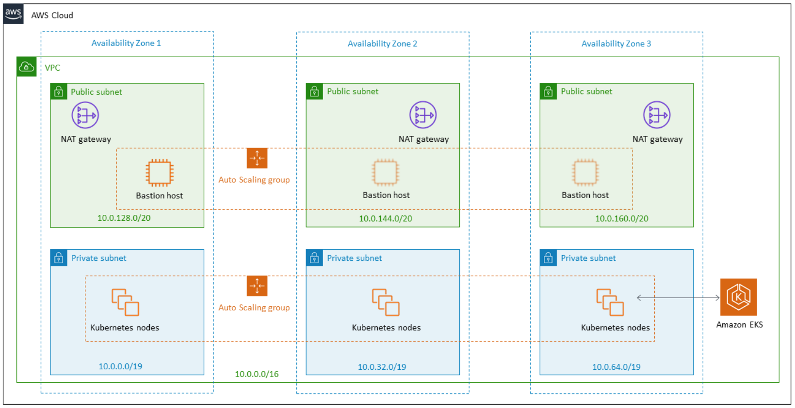
Architecture - Deployment Diagram: Details are elaborated in the next slide.

Slide 4
Architecture - Deployment Diagram - Description:
A highly available architecture that spans three Availability Zones.
A APC, virtual private cloud is configured with public and private subnets according to AWS best practices, to provide you with your own virtual network on AWS.
Managed NAT gateways in the public subnets will allow outbound internet access for resources in the private subnets.
In one public subnet, a Linux bastion host in an Auto Scaling group to allow inbound Secure Shell (SSH) access to Amazon Elastic Compute Cloud (Amazon EC2) instances in private subnets. The bastion host is also configured with the Kubernetes kubectl command line interface for managing the Kubernetes cluster.
An Amazon EKS cluster, which provides the Kubernetes control plane.
In the private subnets, a group of Kubernetes Worker nodes are deployed through Auto Scaling group.

Slide 5
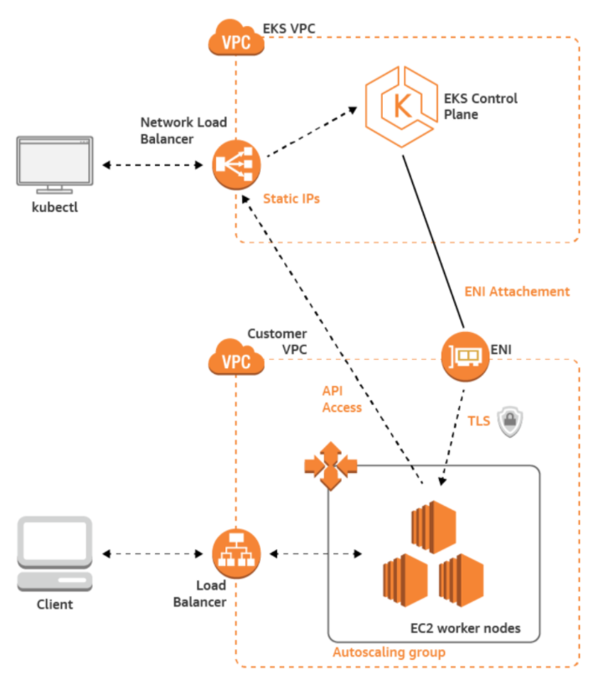
Architecture – Activity diagram: Details are elaborated in the next slide.

Slide 6
Architecture - Activity diagram - Description:
Client will communicate through the Load Balancer and the request goes to Worker nodes.
Worker nodes communicates with EKS Control Plane, formed by EKS cluster, through the Network Load Balancer.
EKS Control Plane, communicates with the Worker nodes through ENI.
Kubectl CLI provides CLI access to EKS Control Plane, in-turn even controls the Worker nodes.
Worker nodes are configured with a Autoscaling group.

Slide 7
Details of the Case Study/ POC:
Deploying an nginx sample application on the Amazon EKS Cluster.
There will an EKS cluster created on the AWS with the Worker nodes connected, which are configured with Auto scaling.

Slide 8
Steps, Hands-on activity:
Create Role – Create IAM role with necessary policies attached to make the user to access EKS services.
Create VPC – Through a CloudFormation template, to create the necessary secured networking for the EKS services.
Create EKS Cluster.
Install Kubectl – Used to access EKS cluster through CLI.
Install Eksctl – Enables the users to access the EKS services through CLI.
Install aws-iam-authenticator - Enables the users to authenticate and access the EKS Cluster through CLI from the remote systems.
Create Worker nodes.
Map the worker nodes with EKS Cluster.
Deploy the Sample application.
Delete Worker nodes and the EKS Cluster.

Slide 9
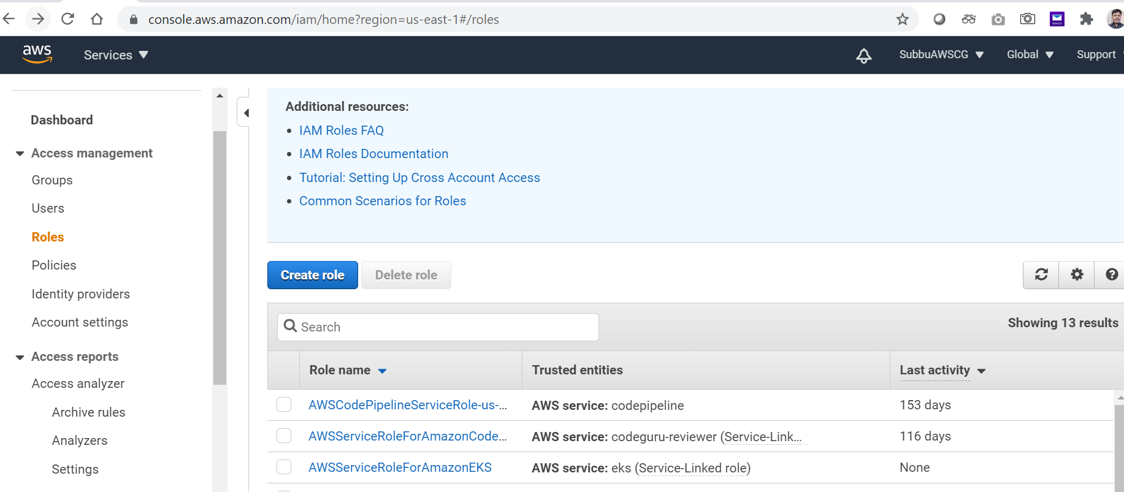
# Create Role:

Slide 10
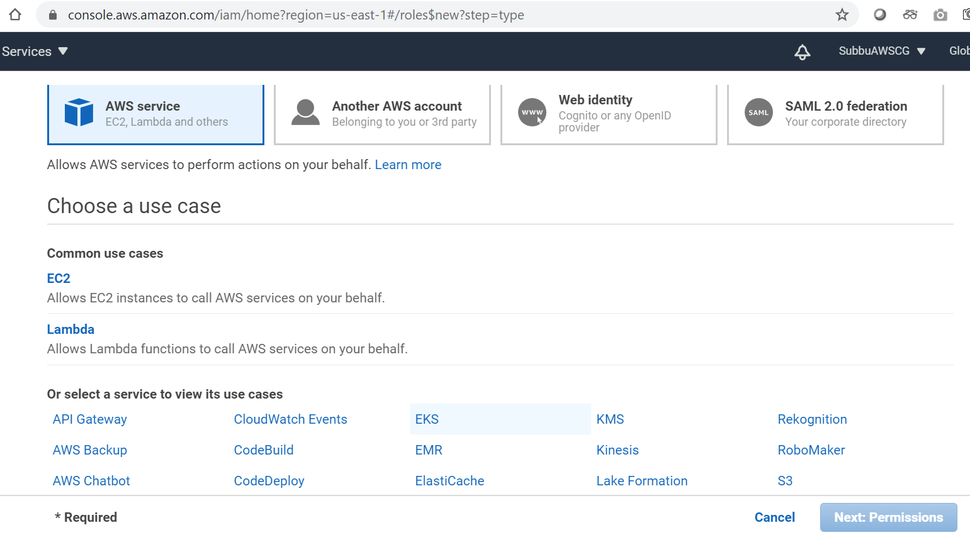
Choose the EKS service:

Slide 11
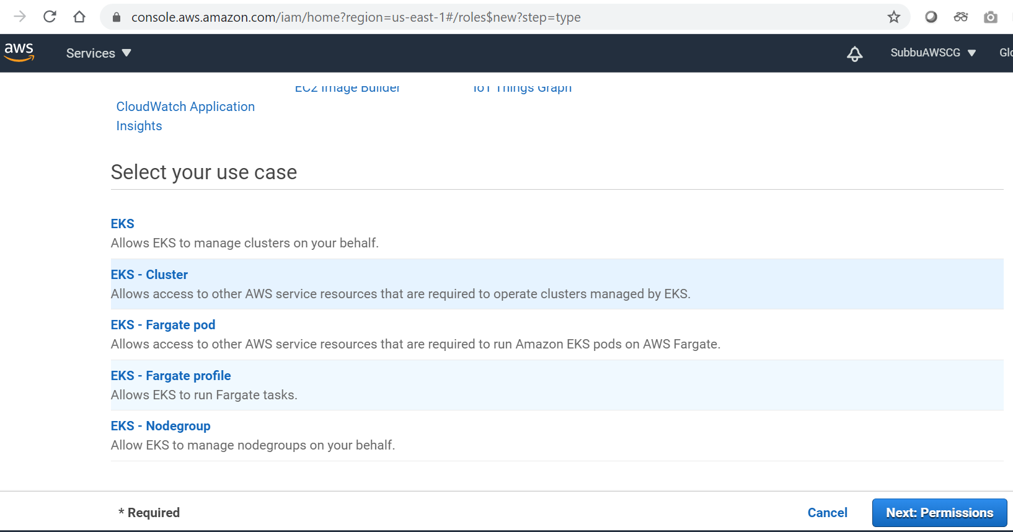
Choose the appropriate use case:

Slide 12
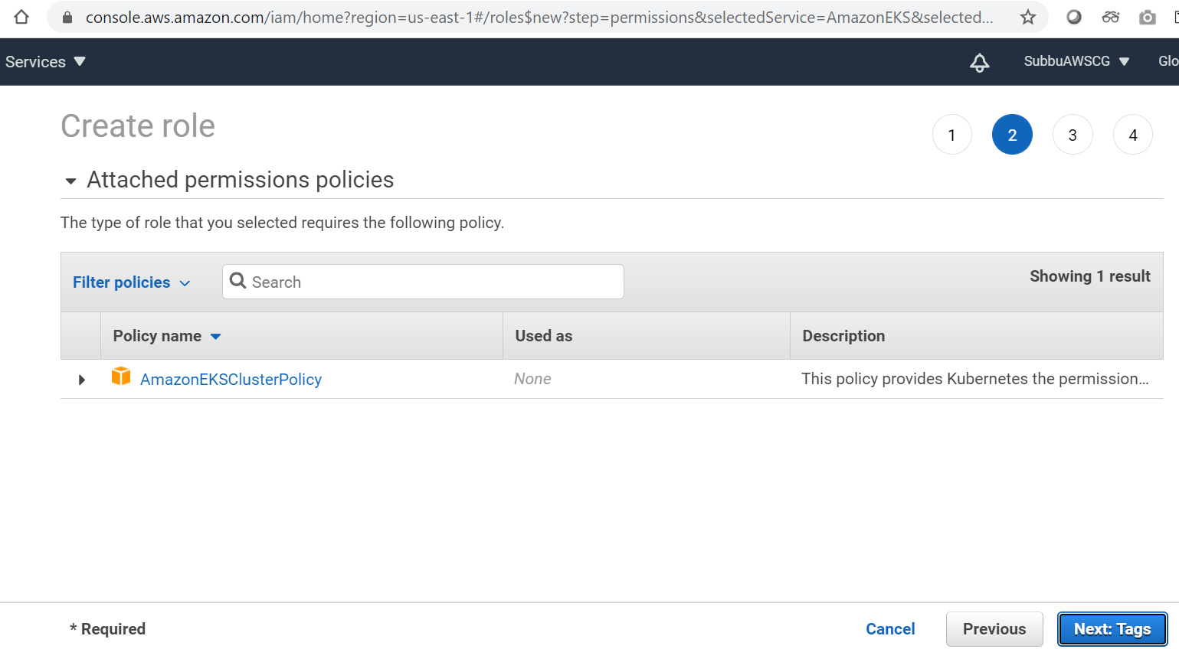
Attach the Policy: AmazonEKSClusterPolicy.

Slide 13
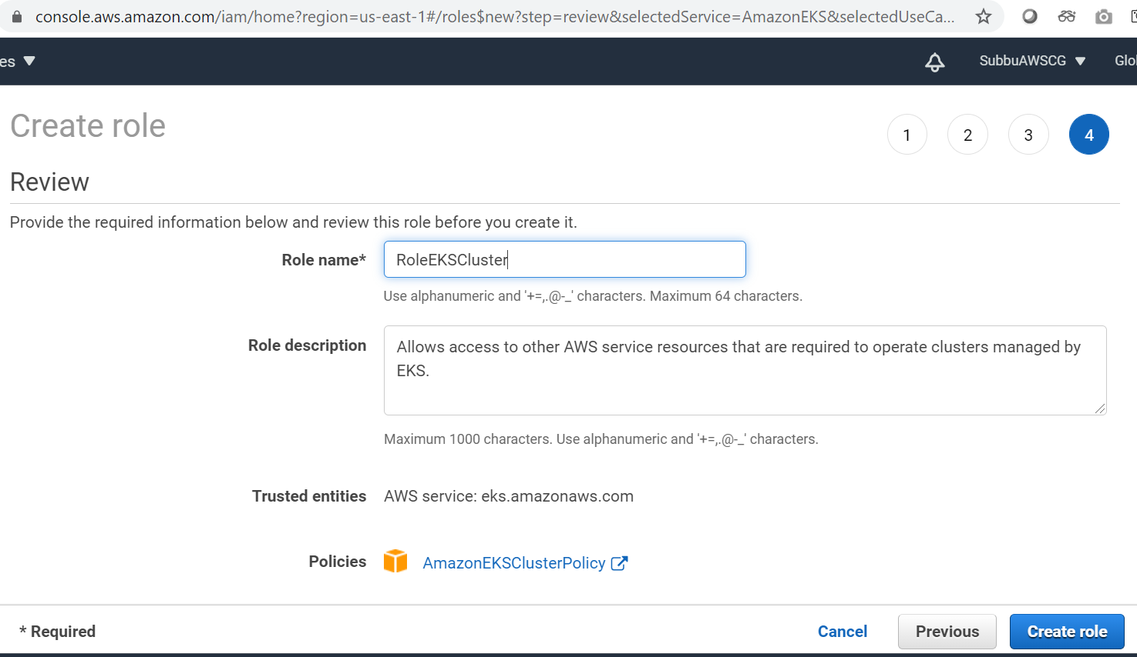
Give the Role name:

Slide 14
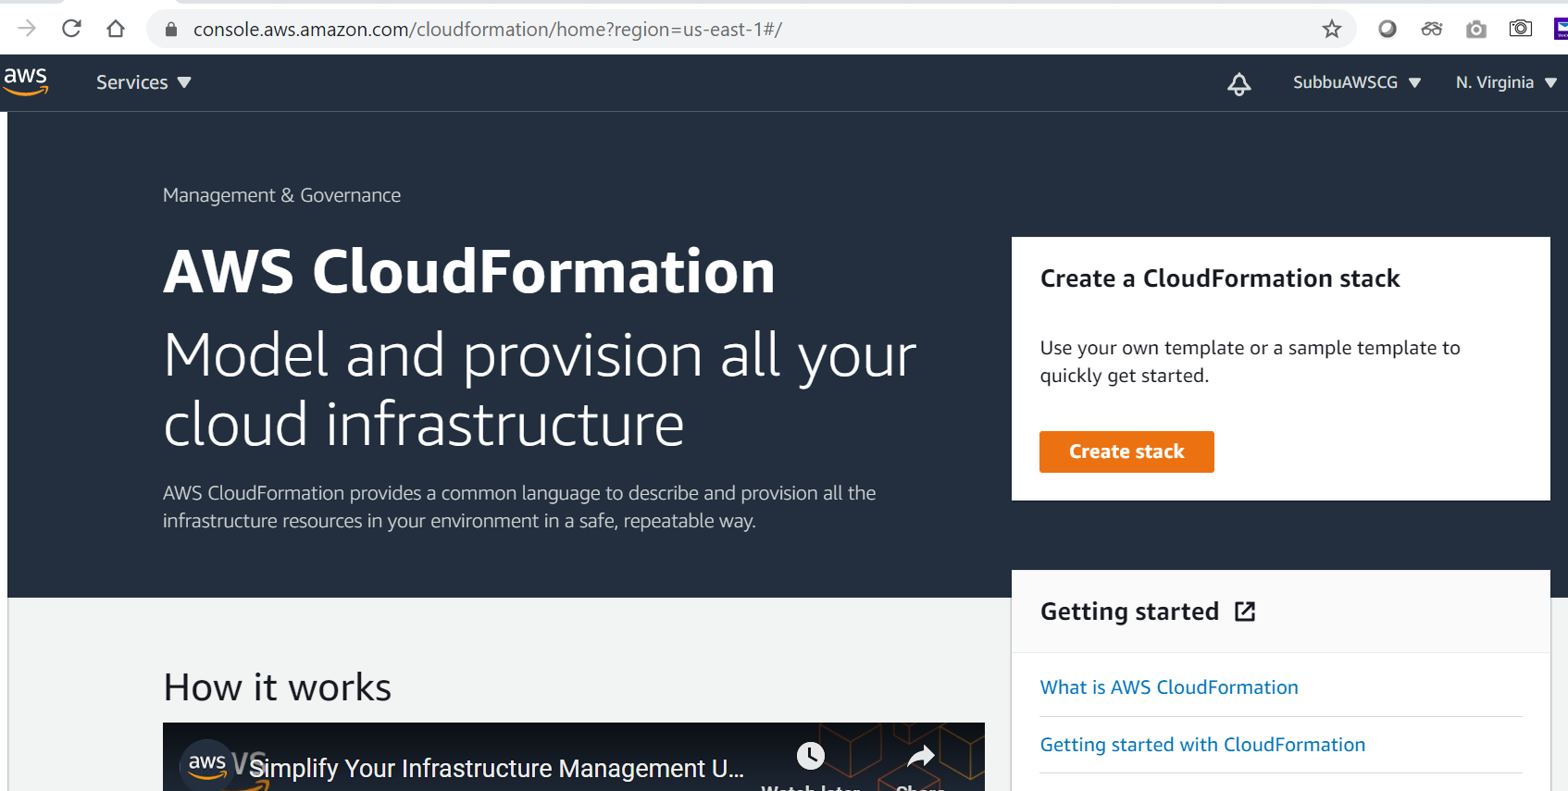
# Create VPC: using CloudFormation template.

Slide 15
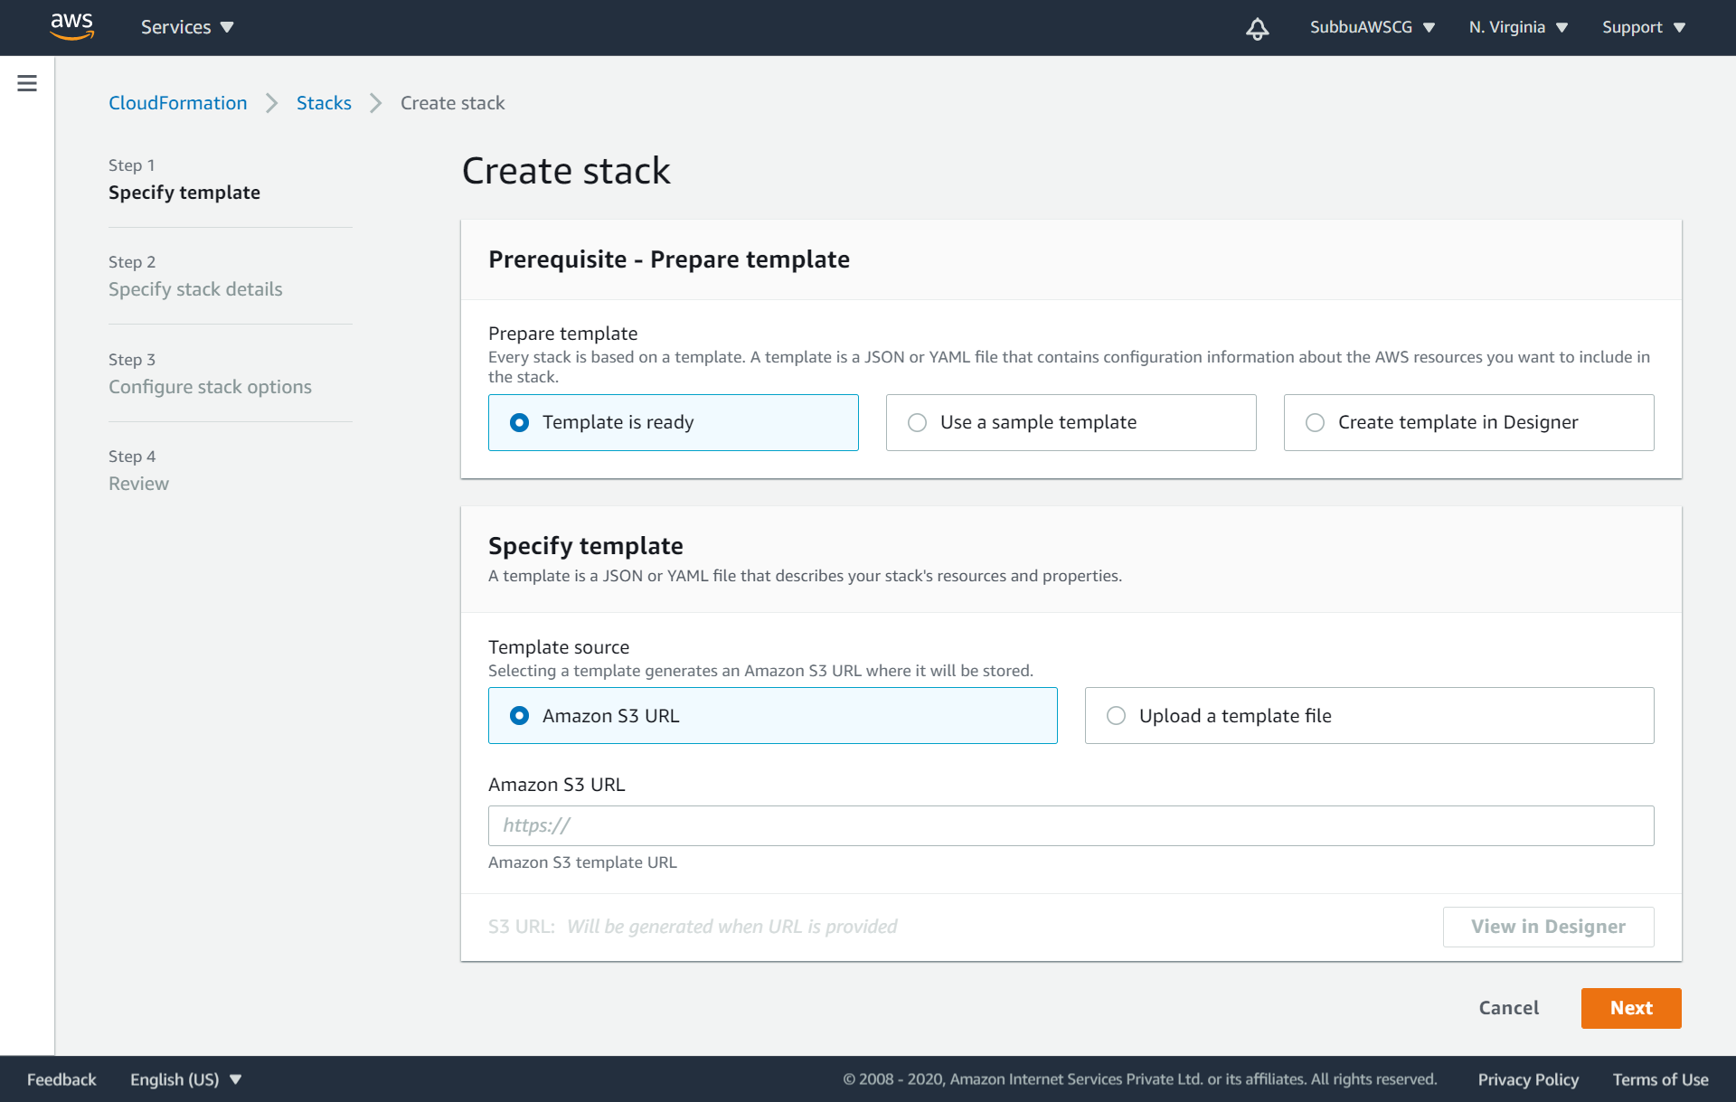
Choose the ready template from S3:

Slide 16
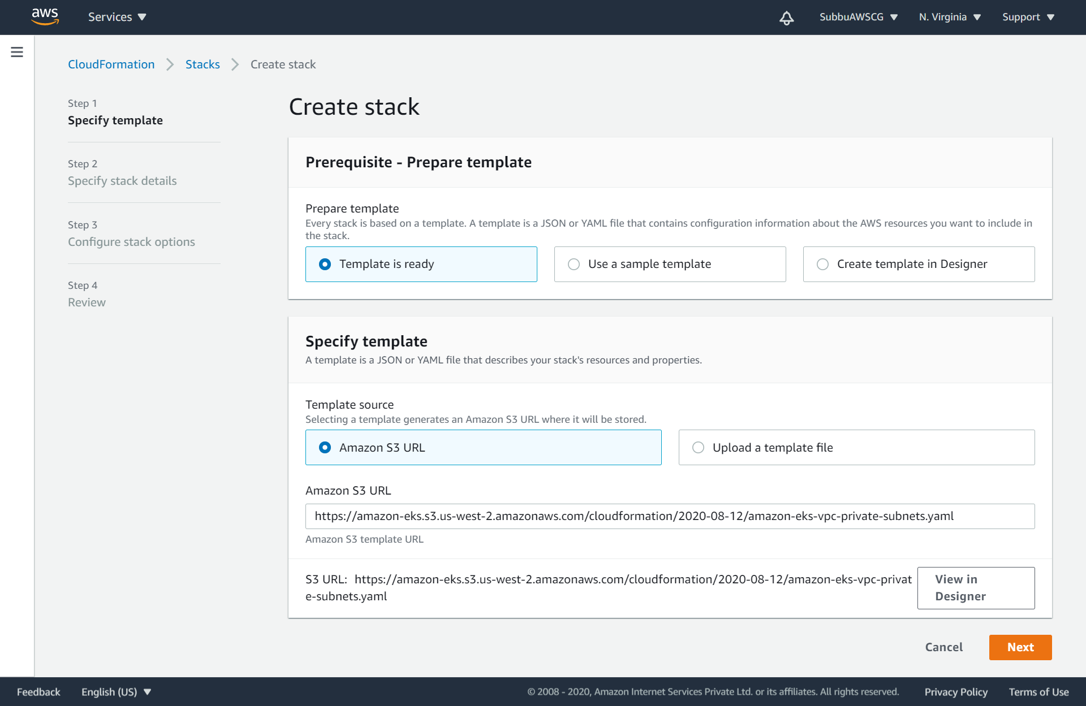
Get the S3 URL from the AWS documentation in the below link: https://docs.aws.amazon.com/eks/latest/userguide/create-public-private-vpc.html https://amazon-eks.s3.us-west-2.amazonaws.com/cloudformation/2020-08-12/amazon-eks-vpc-private-subnets.yaml

Slide 17
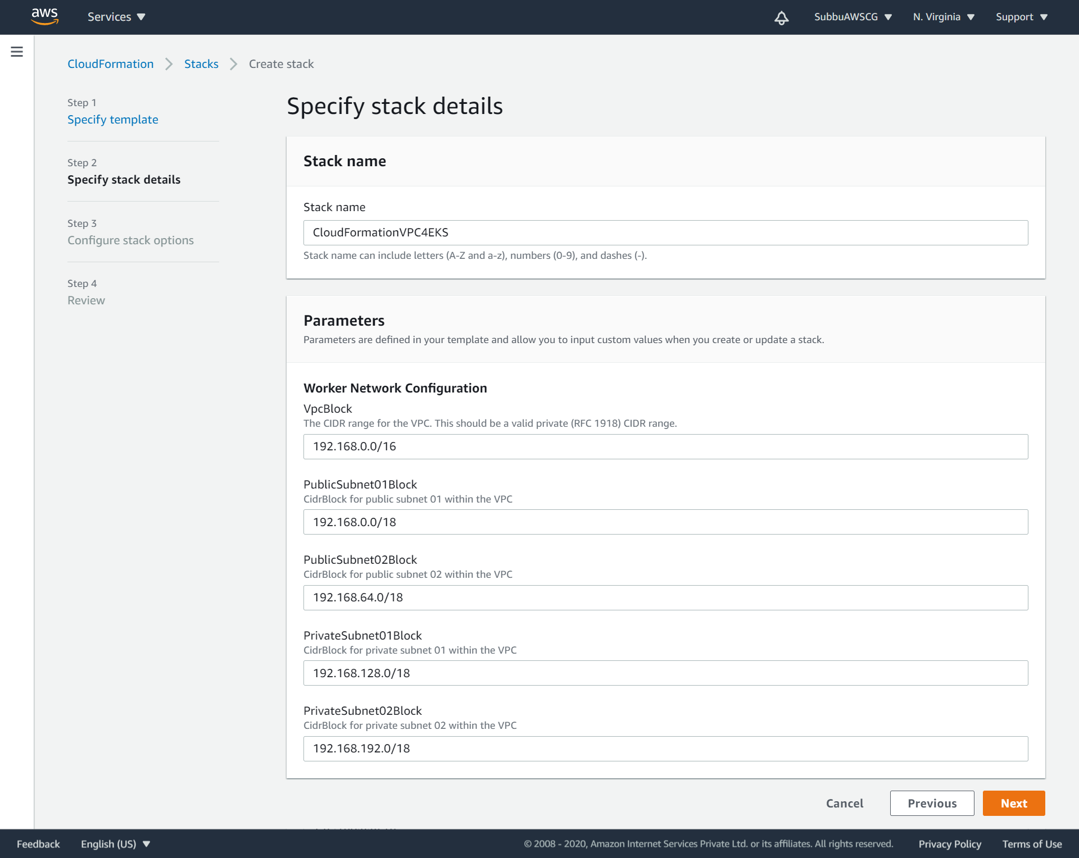
Give a stack name and the predefined VPC configurations will get loaded from S3:

Slide 18
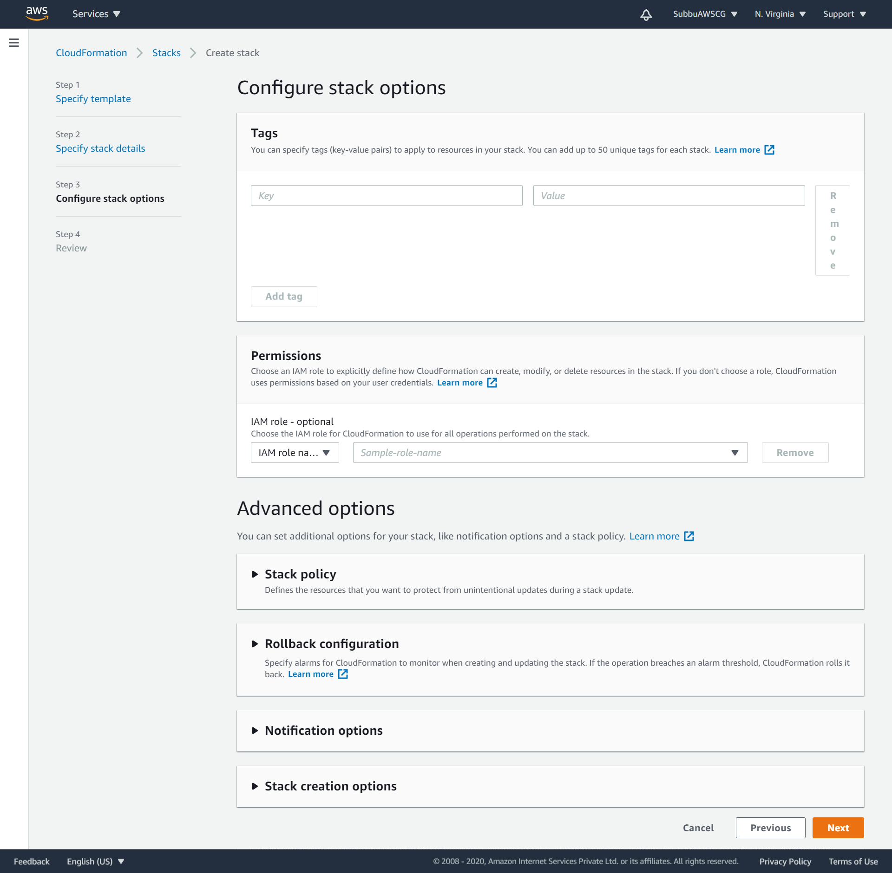
Input more advanced options if needed:

Slide 19
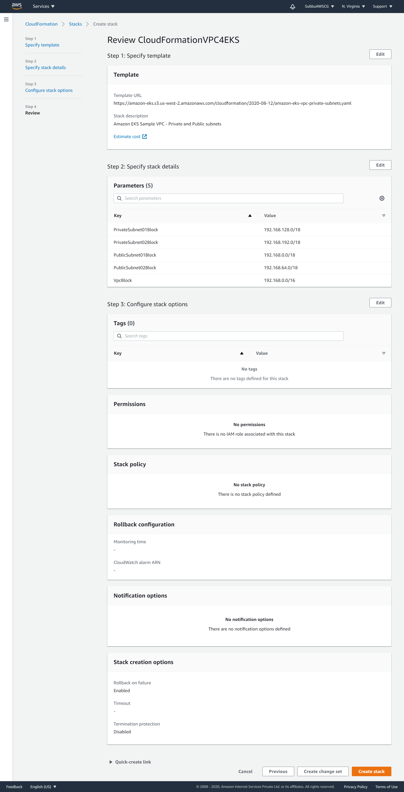
Review VPC details:

Slide 20
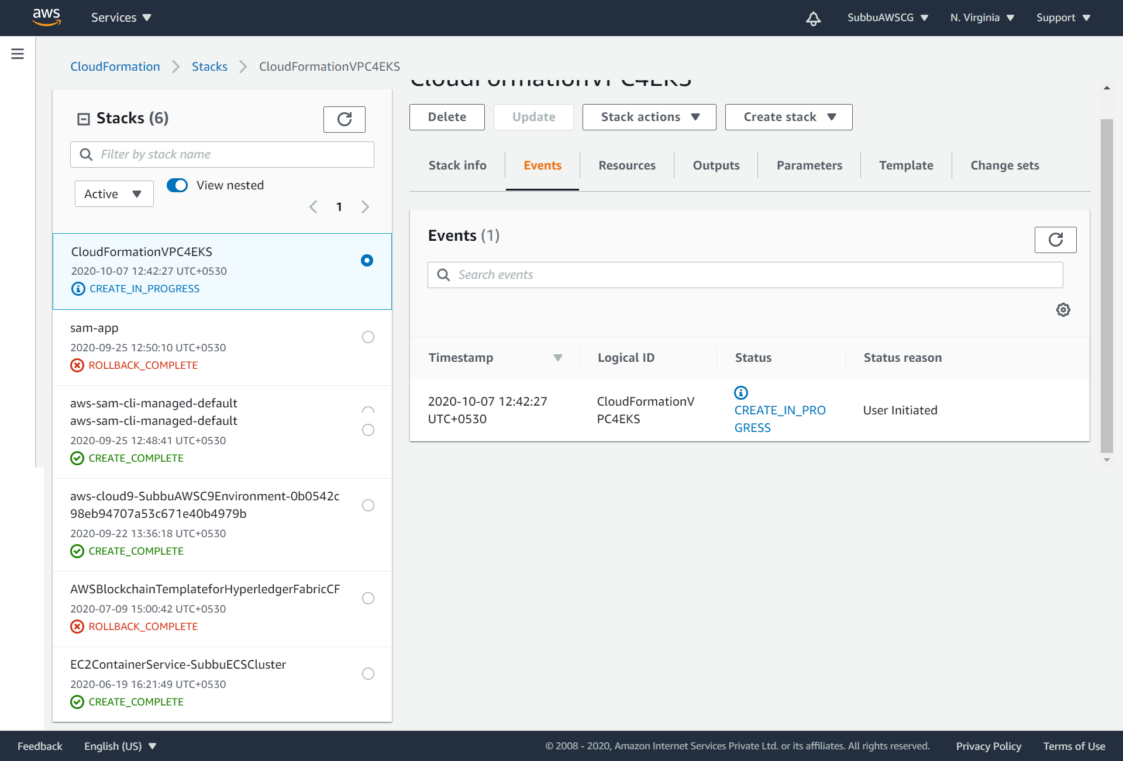
VPC creation through CloudFormation is in progress:

Slide 21
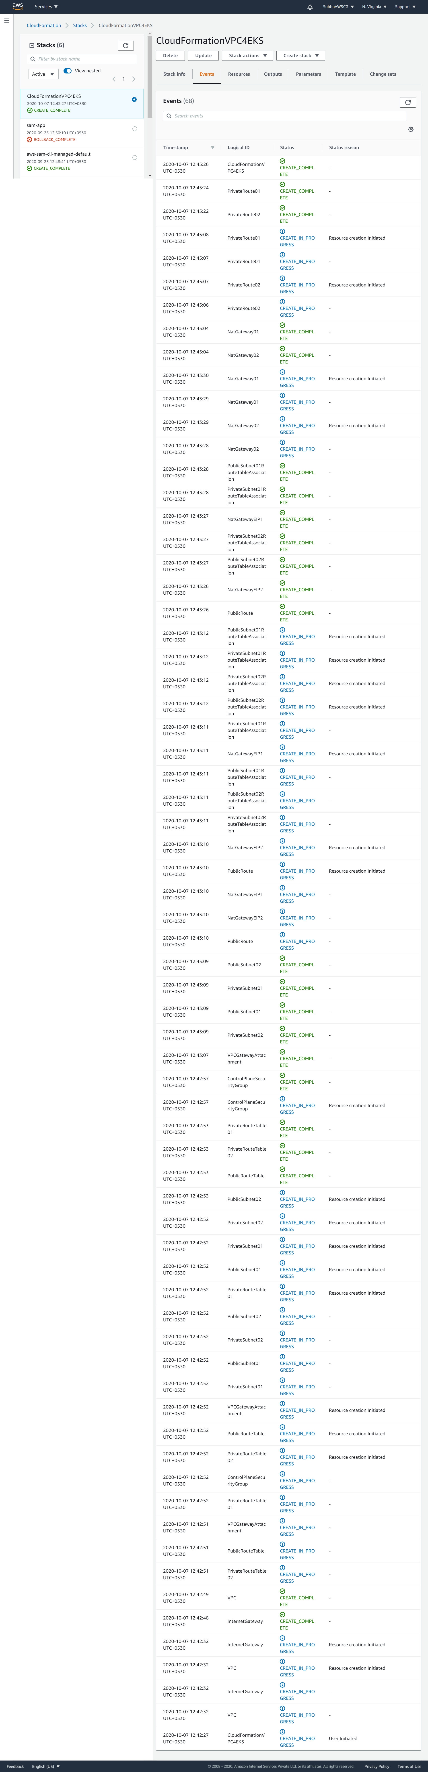
Detailed logs of VPC creation through CloudFormation:

Slide 22
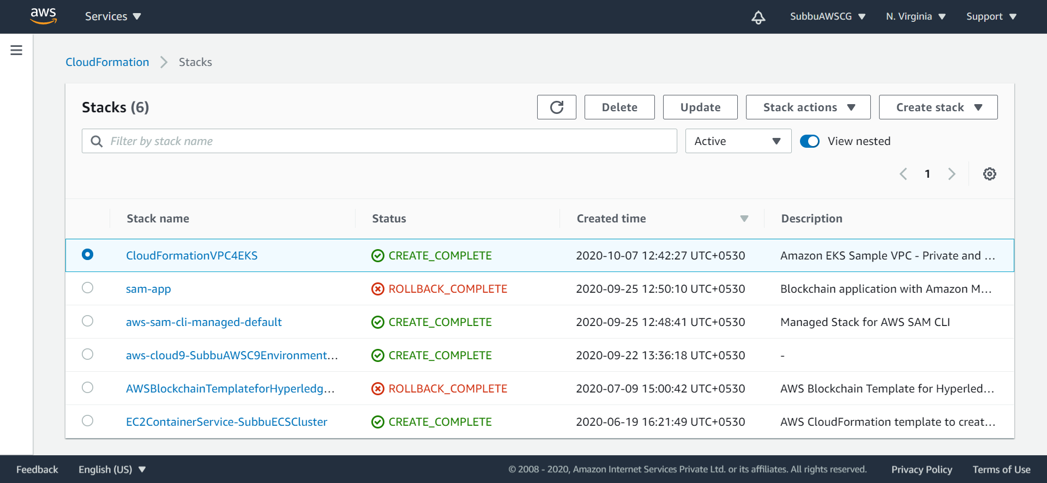
VPC create is complete through CloudFormation:

Slide 23
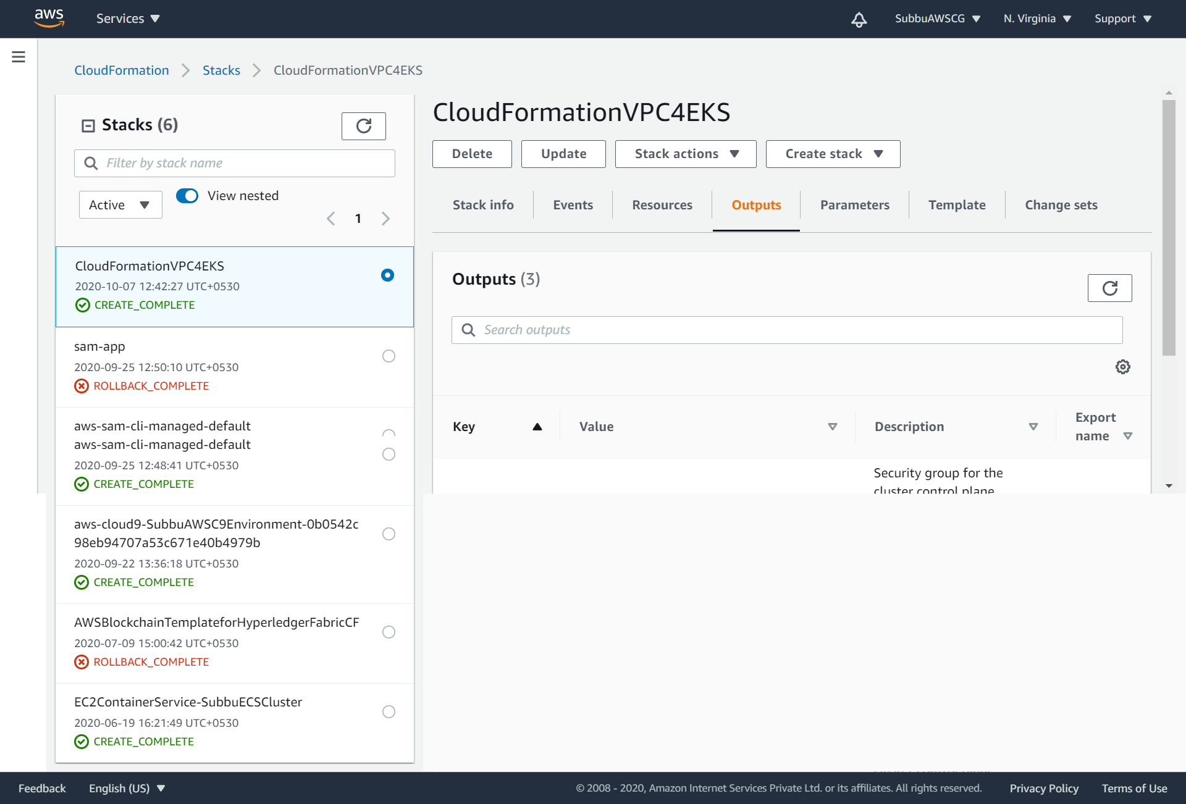
The view of VPC CloudFormation output:

Slide 24
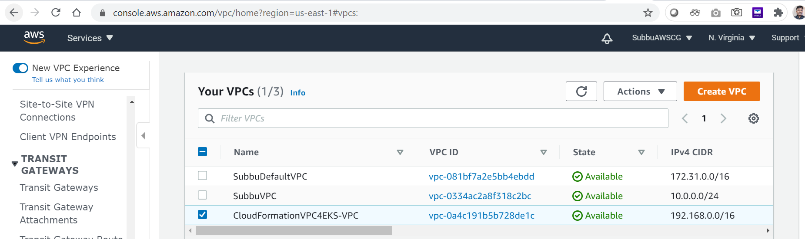
Created VPC:

Slide 25
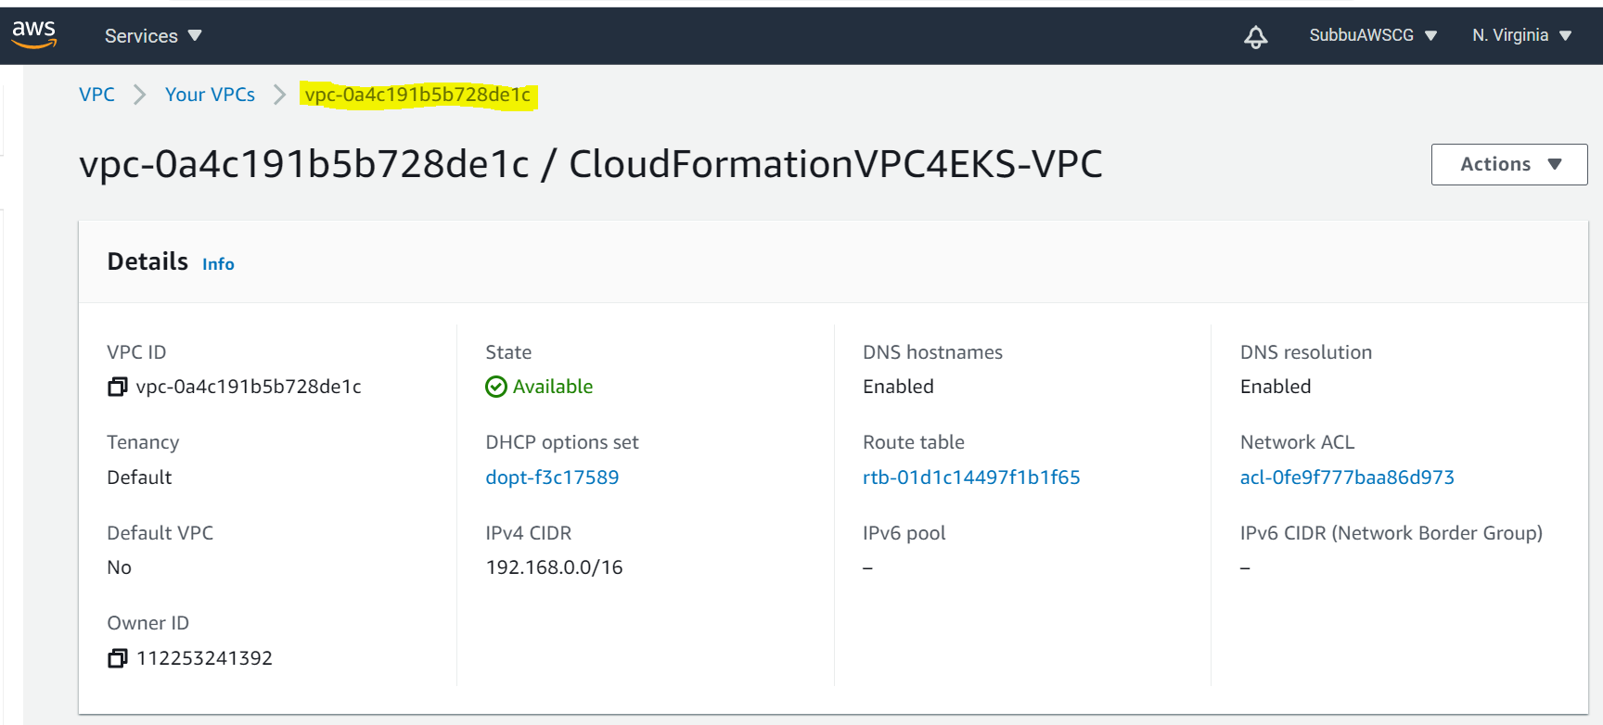
Details of created VPC:

Slide 26
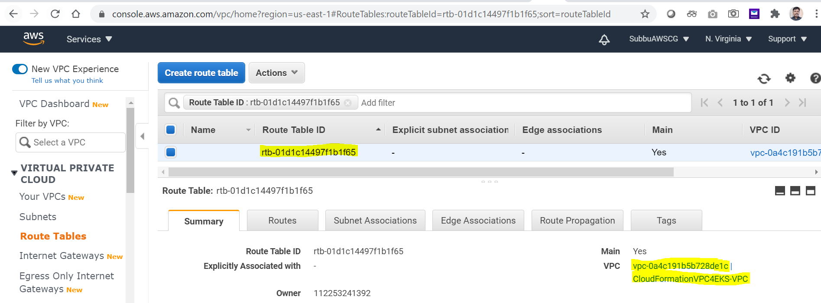
Route table, that automatically comes with the VPC:

Slide 27
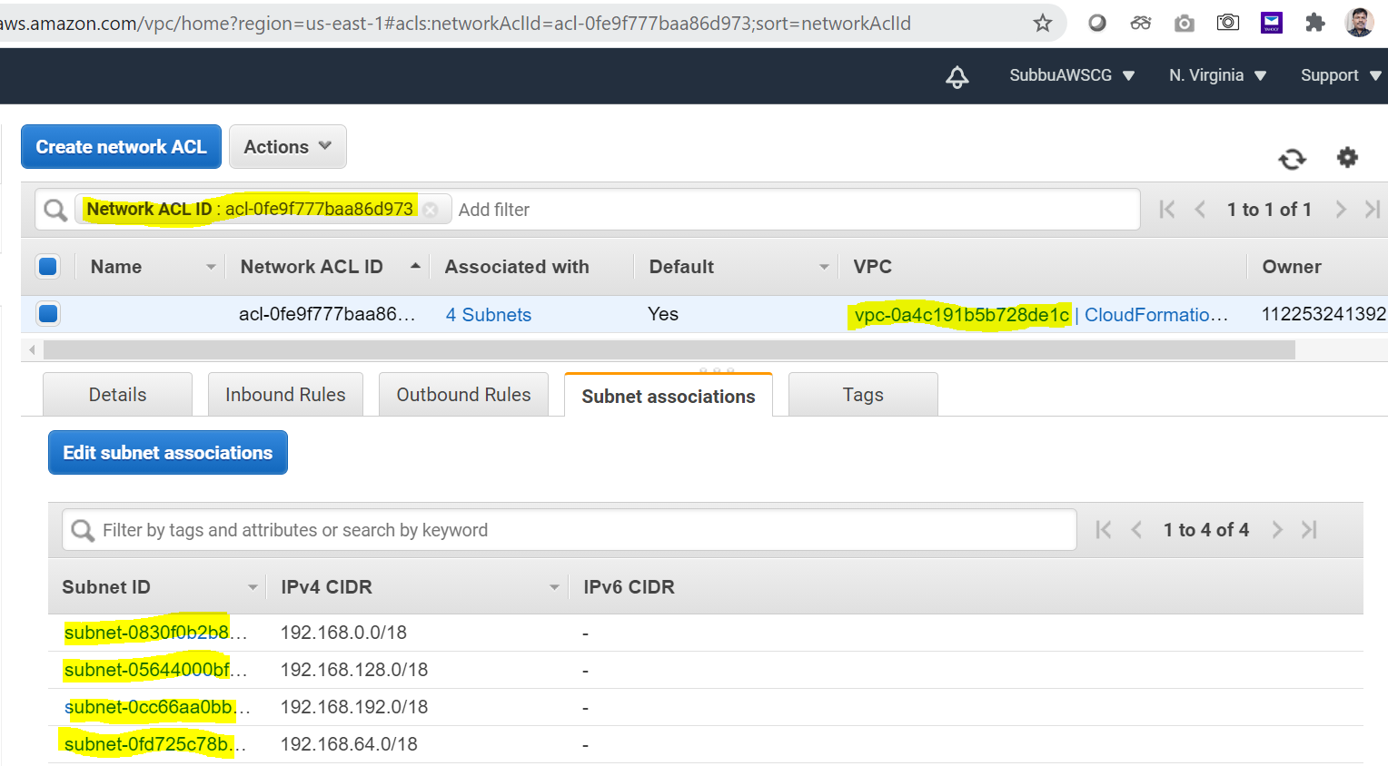
Details of Network ACL (Access Control List) associated with VPC:

Slide 28
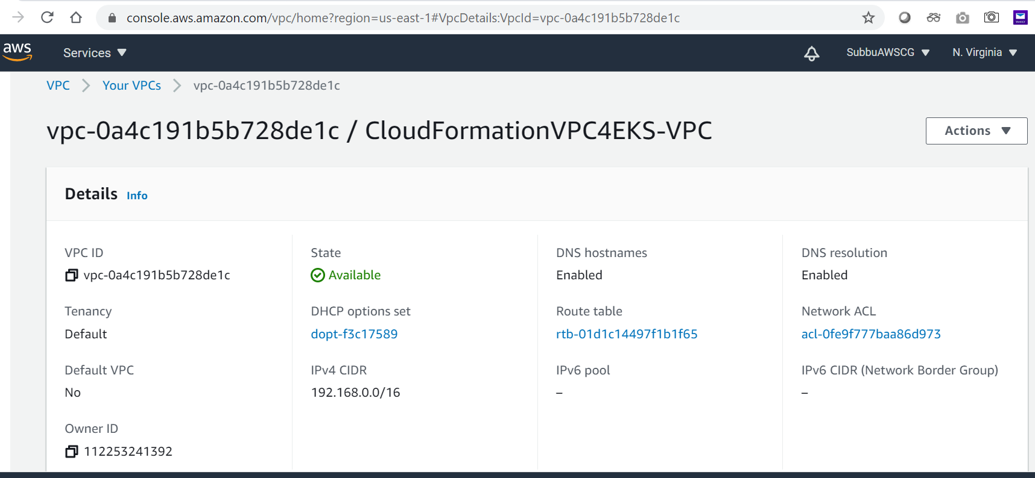
Created VPC from the CloudFront:

Slide 29
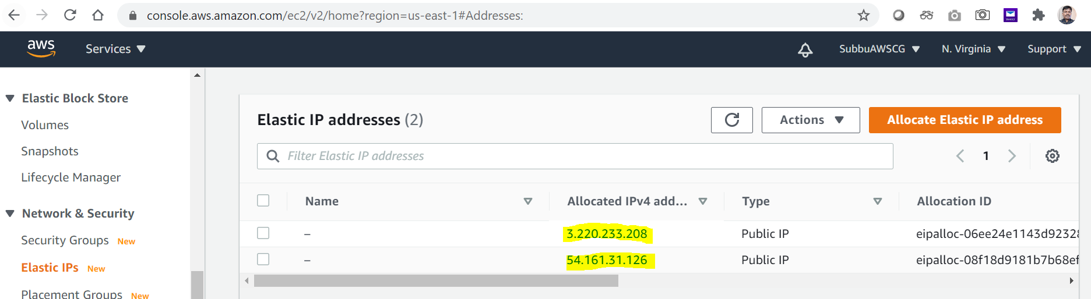
Elastic IP addresses' created:

Slide 30
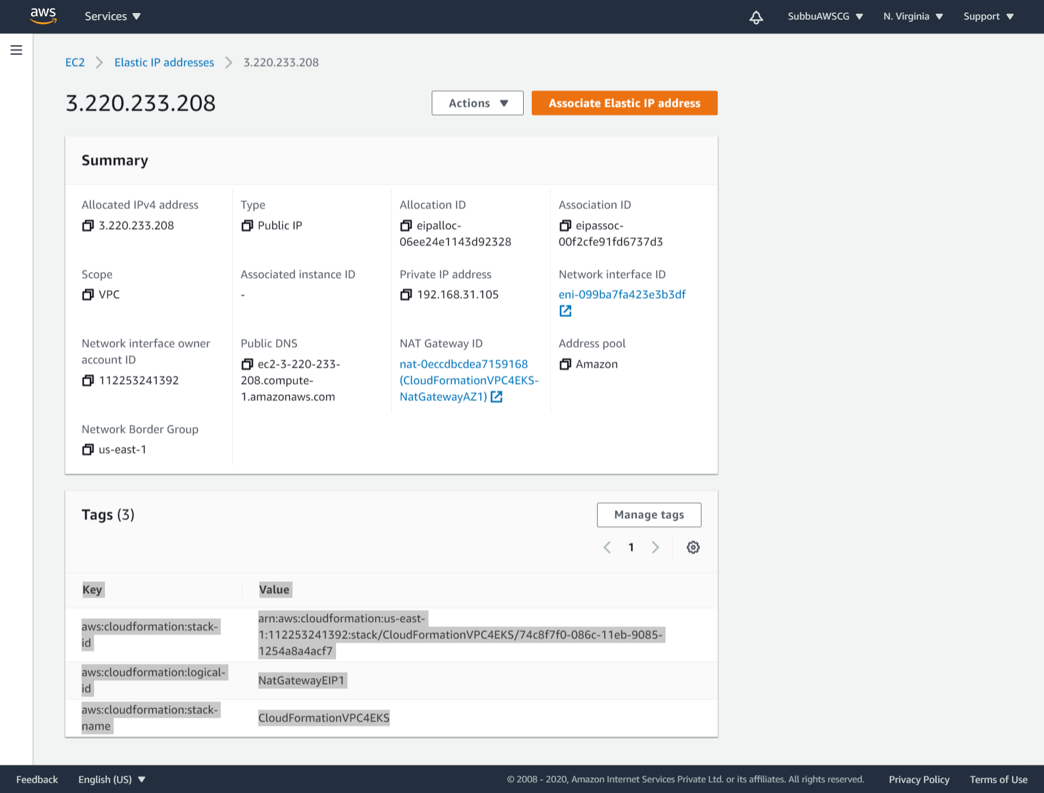
Details of the EIP’s:

Slide 31
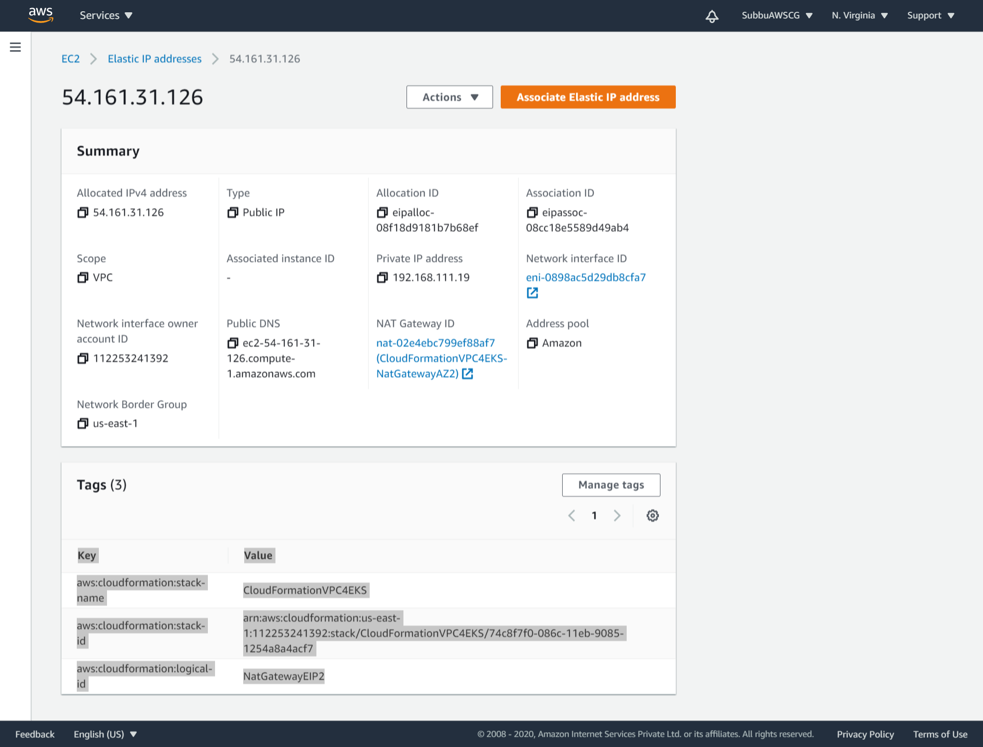
Details of the EIP’s:

Slide 32
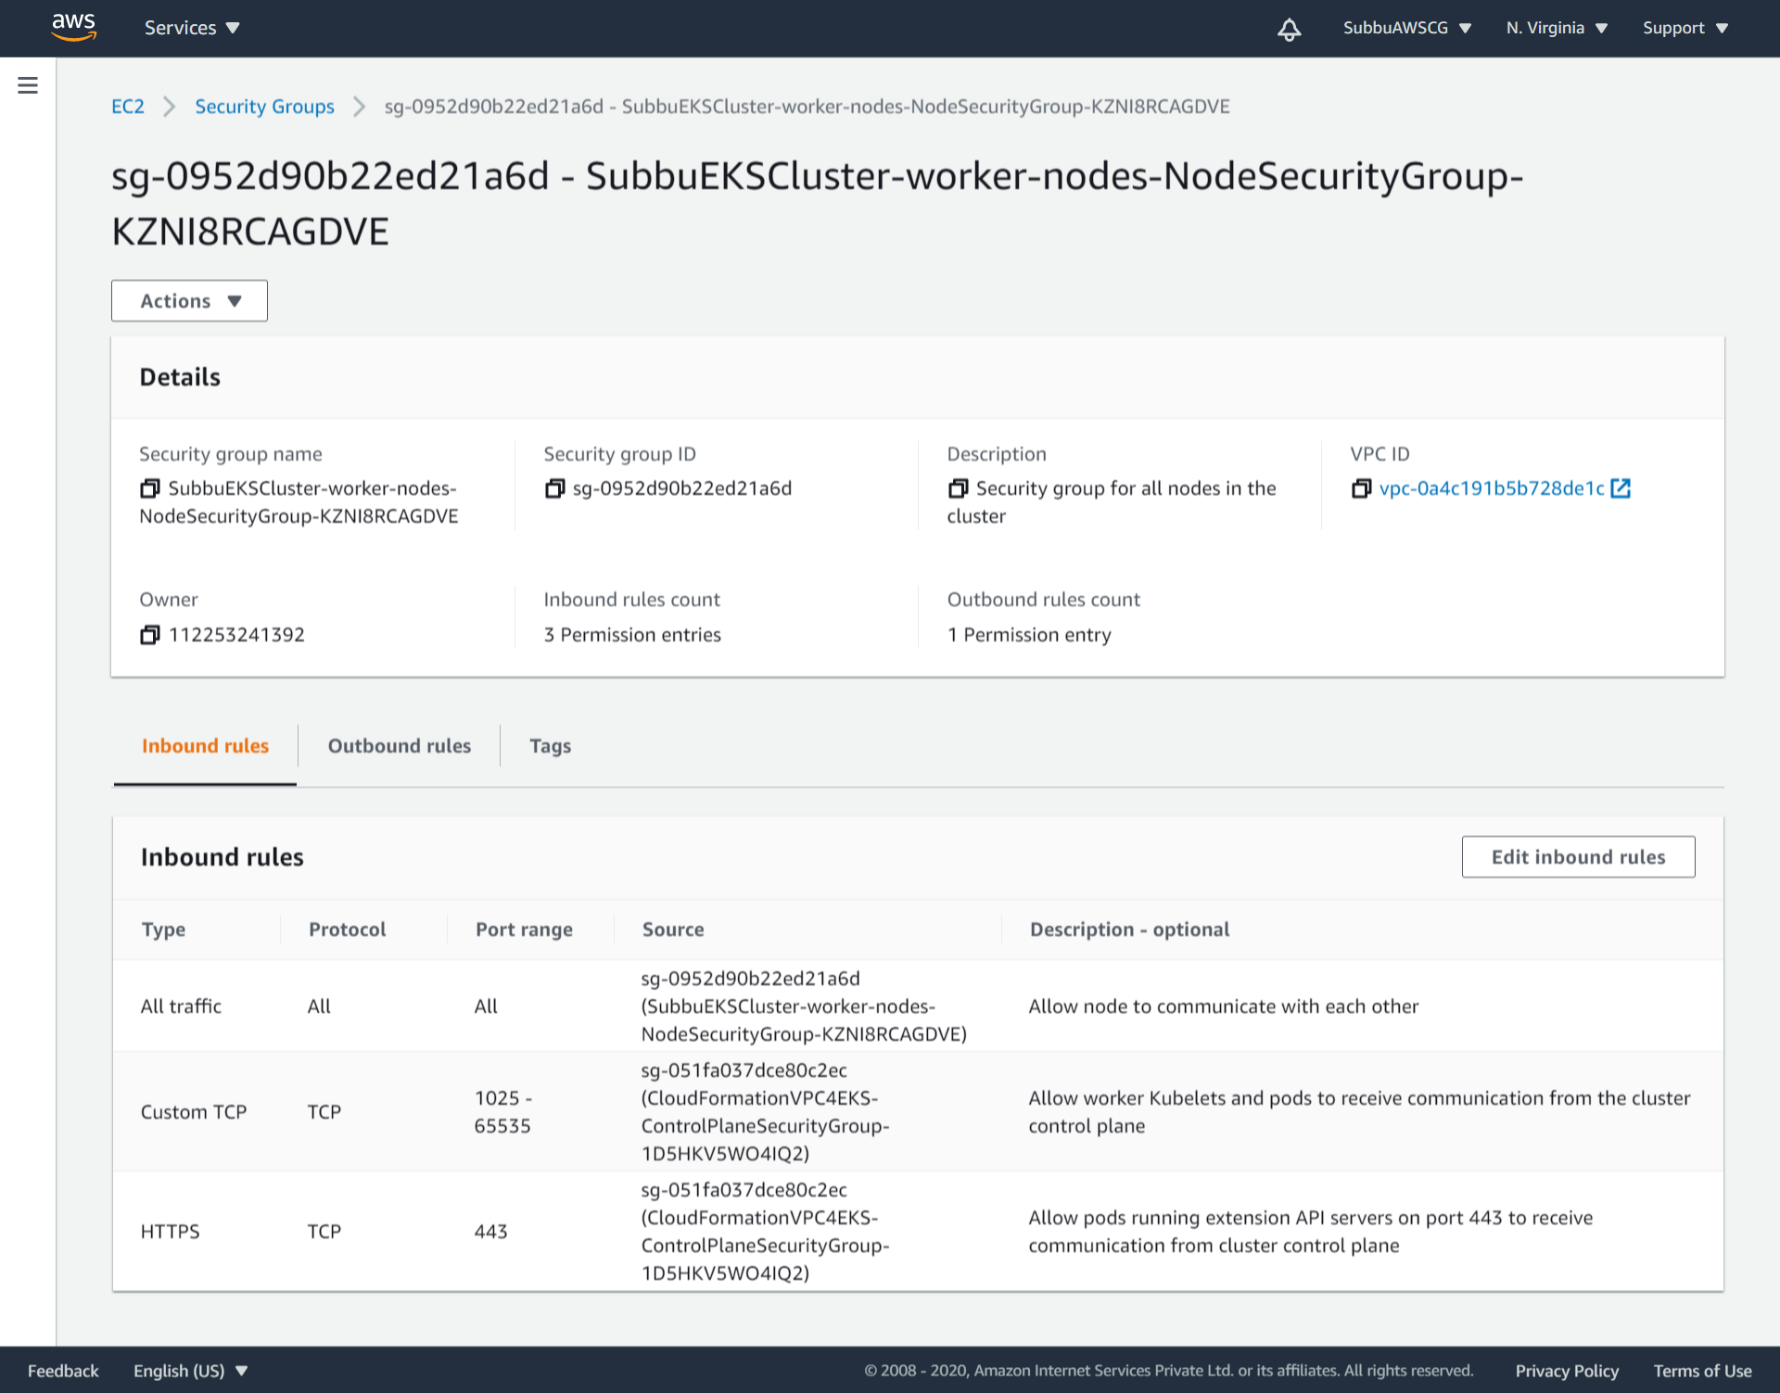
Security Group, formed along with the VPC – Inbound:

Slide 33
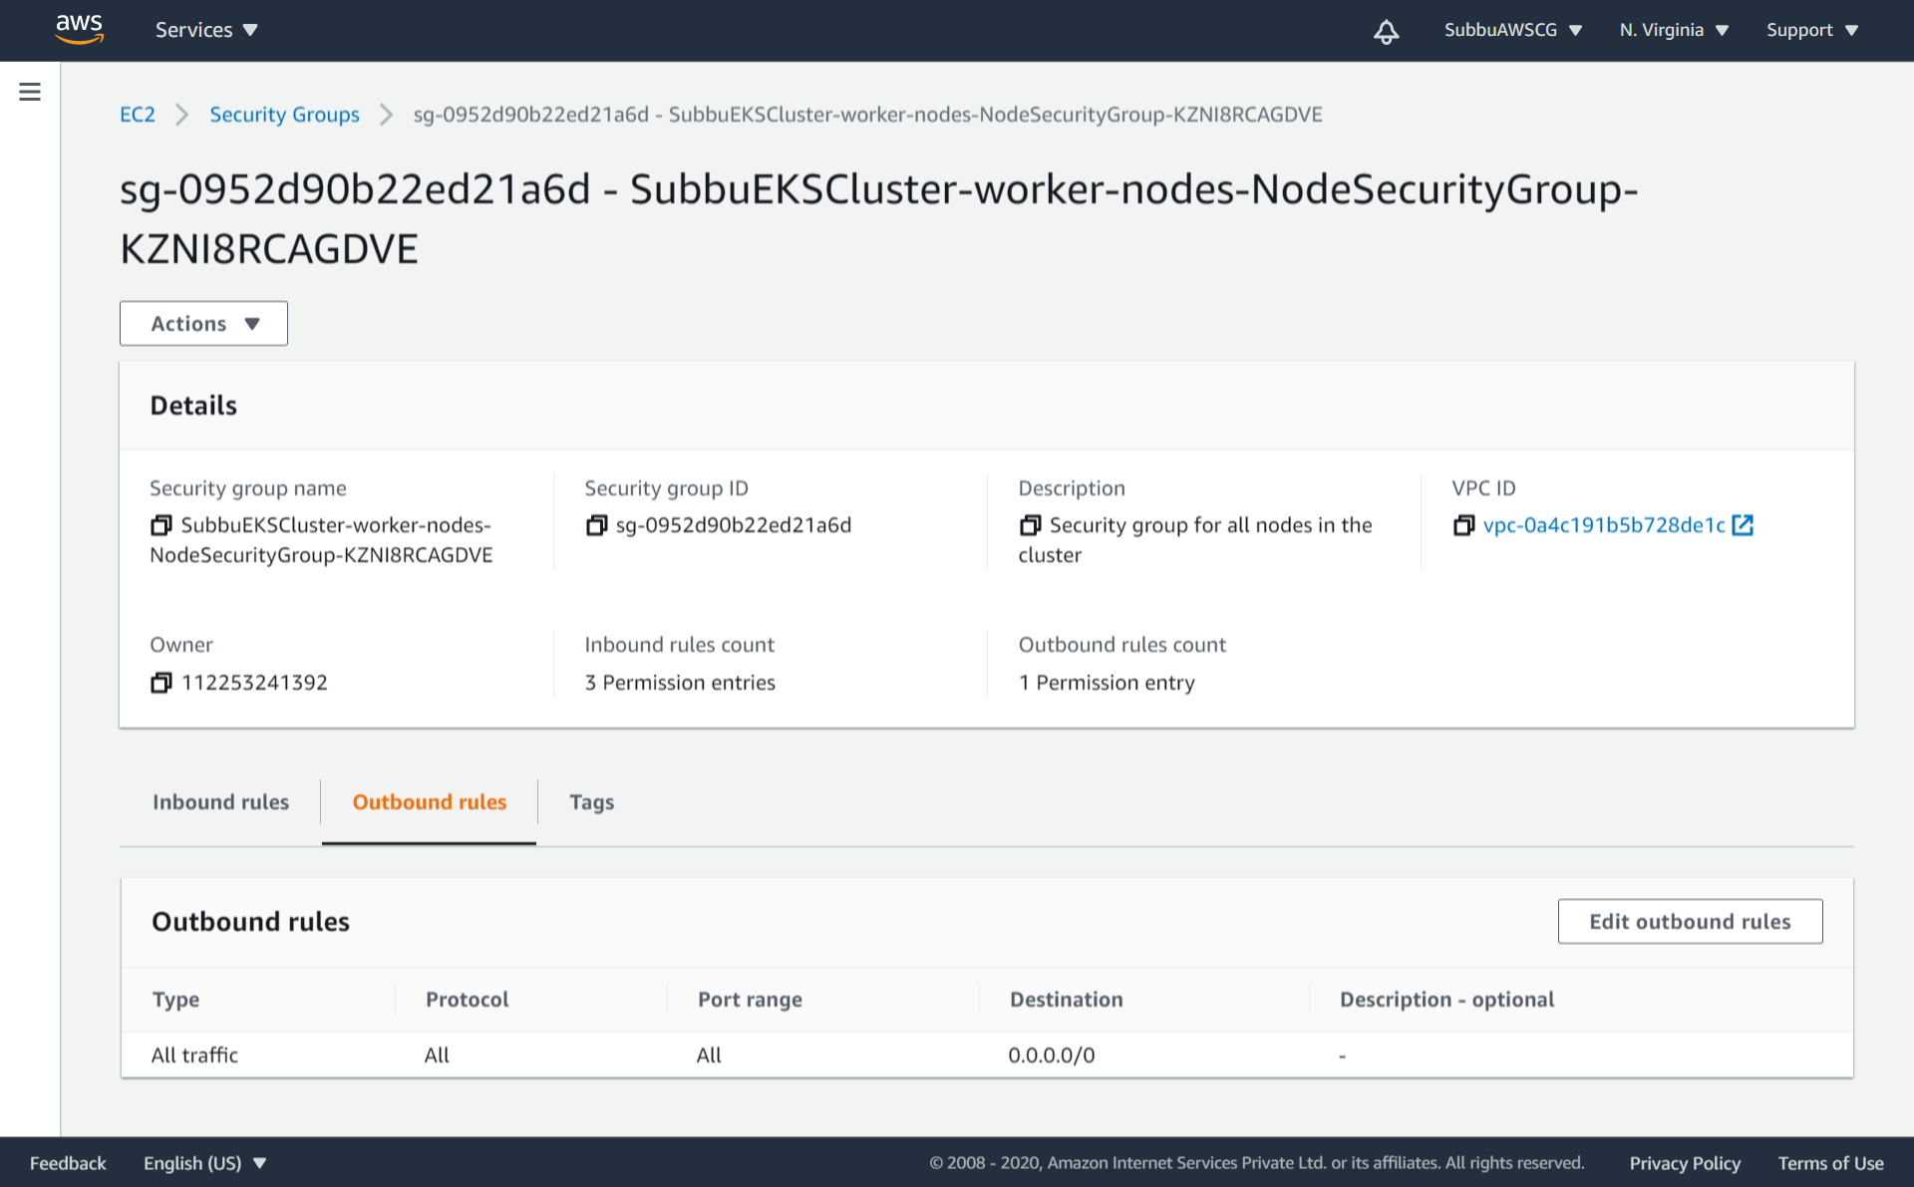
Security Group, formed along with the VPC – Outbound:

Slide 34
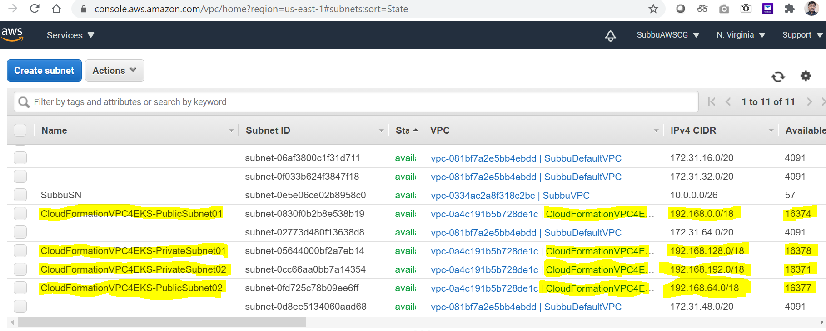
Created Subnet’s, as a part of VPC with CloudFormation execution:

Slide 35
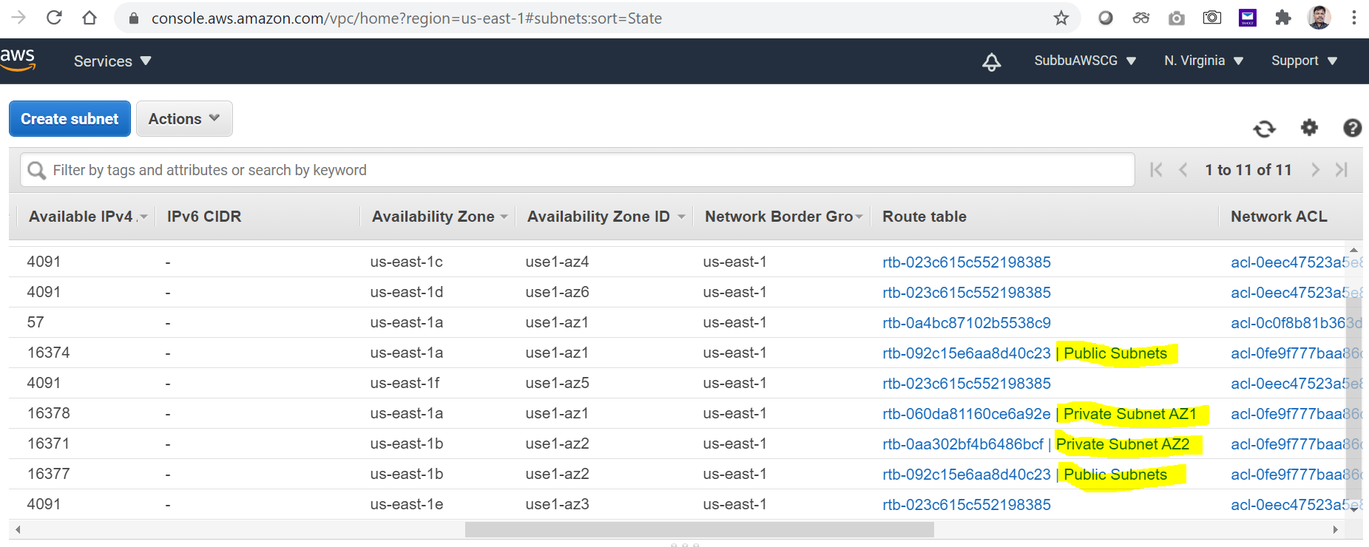
Subnet’s and the Route tables:

Slide 36
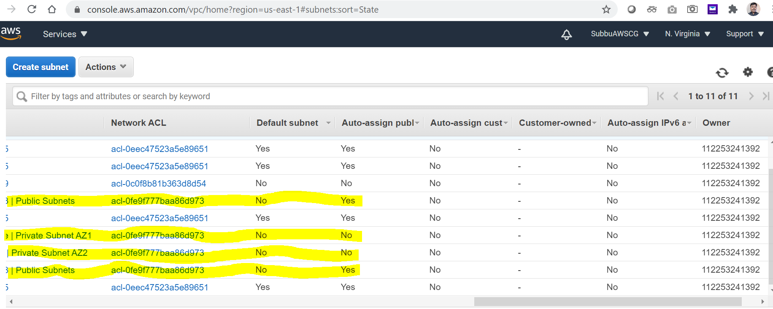
Subnets and their Auto assigned public IP status:

Slide 37
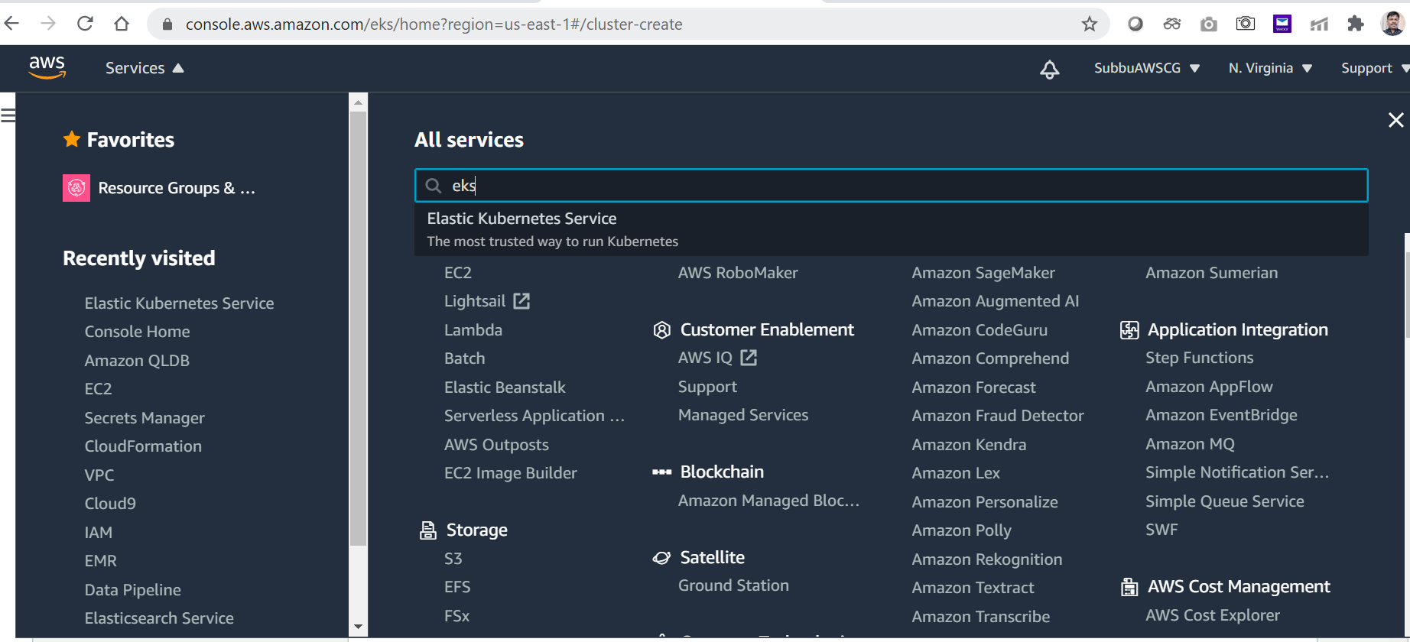
# Create Amazon EKS Cluster:

Slide 38
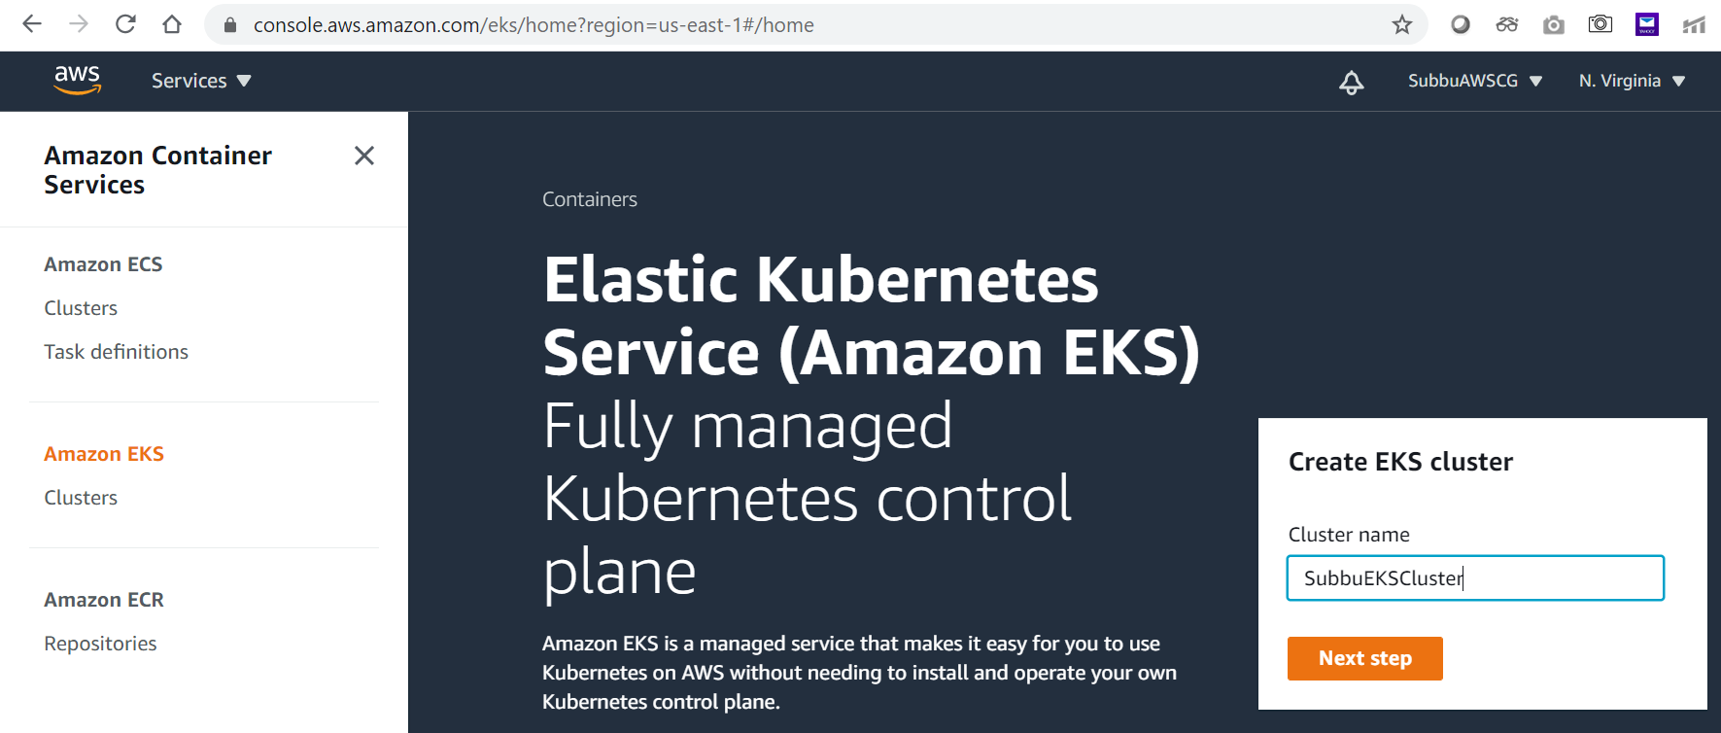
Give a name for your EKS cluster:

Slide 39
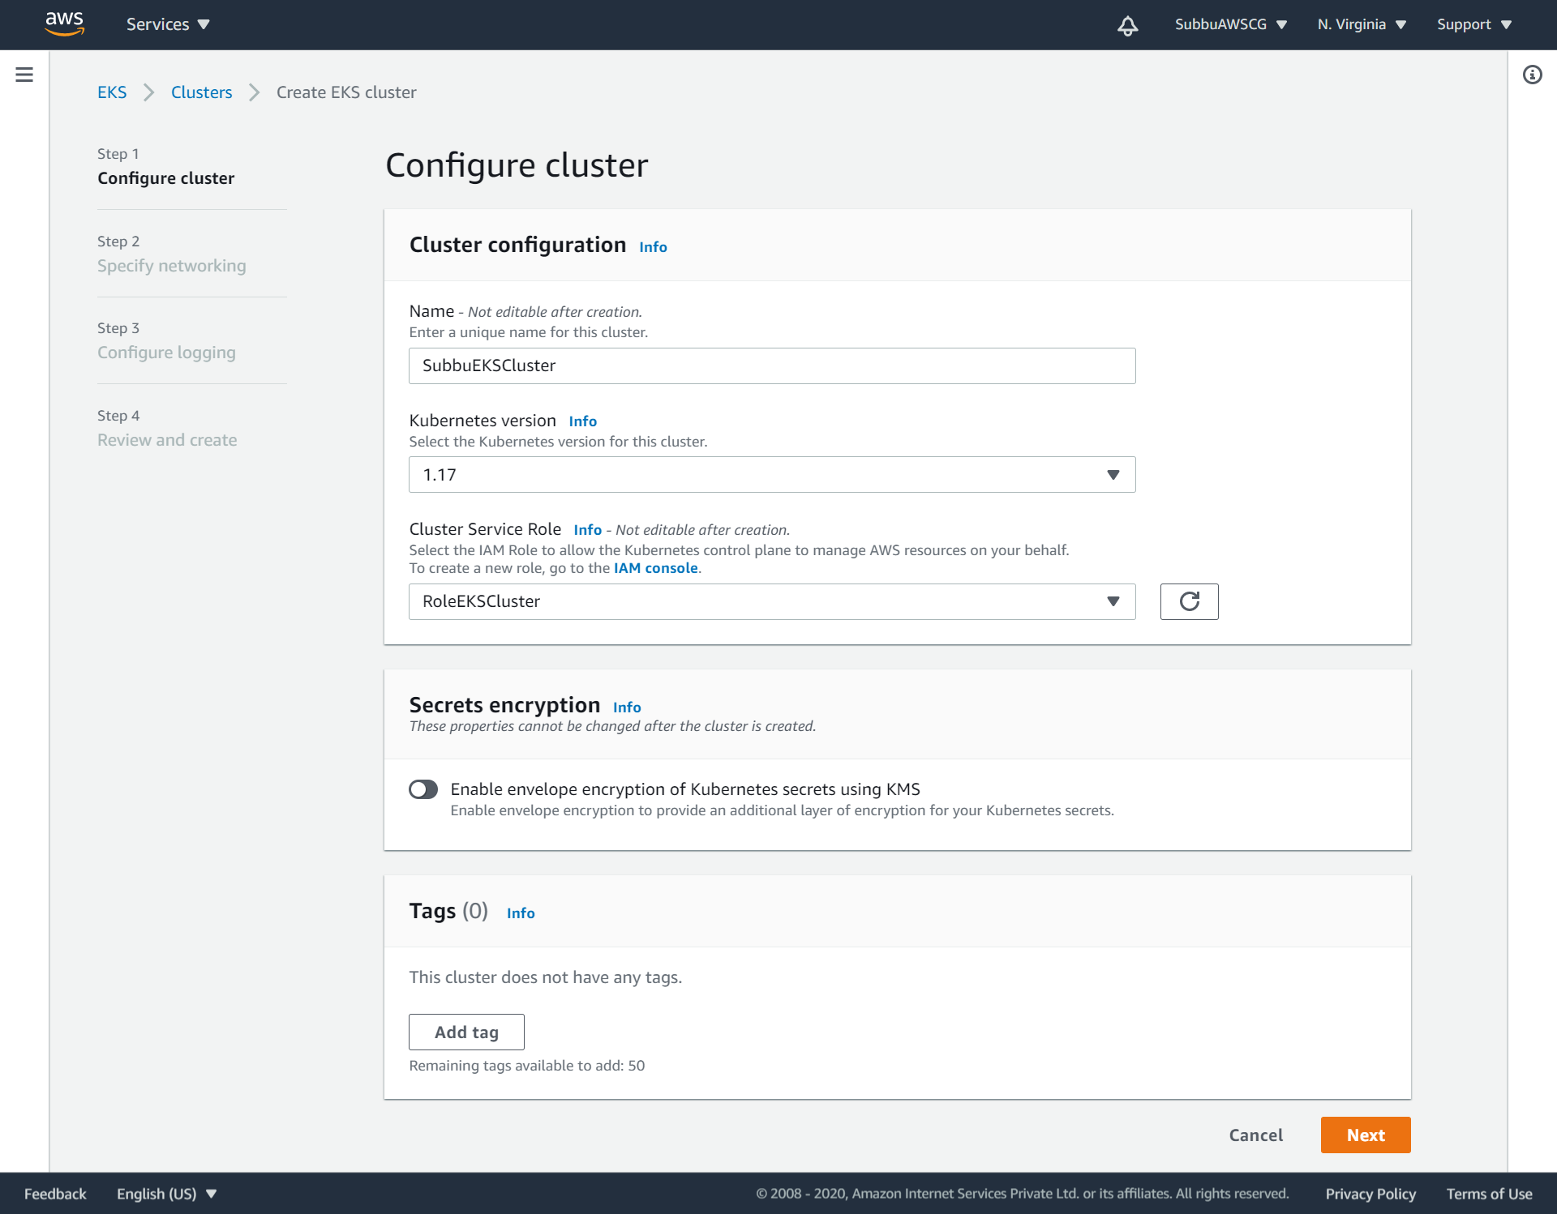
Choose the EKS Role that we created:

Slide 40
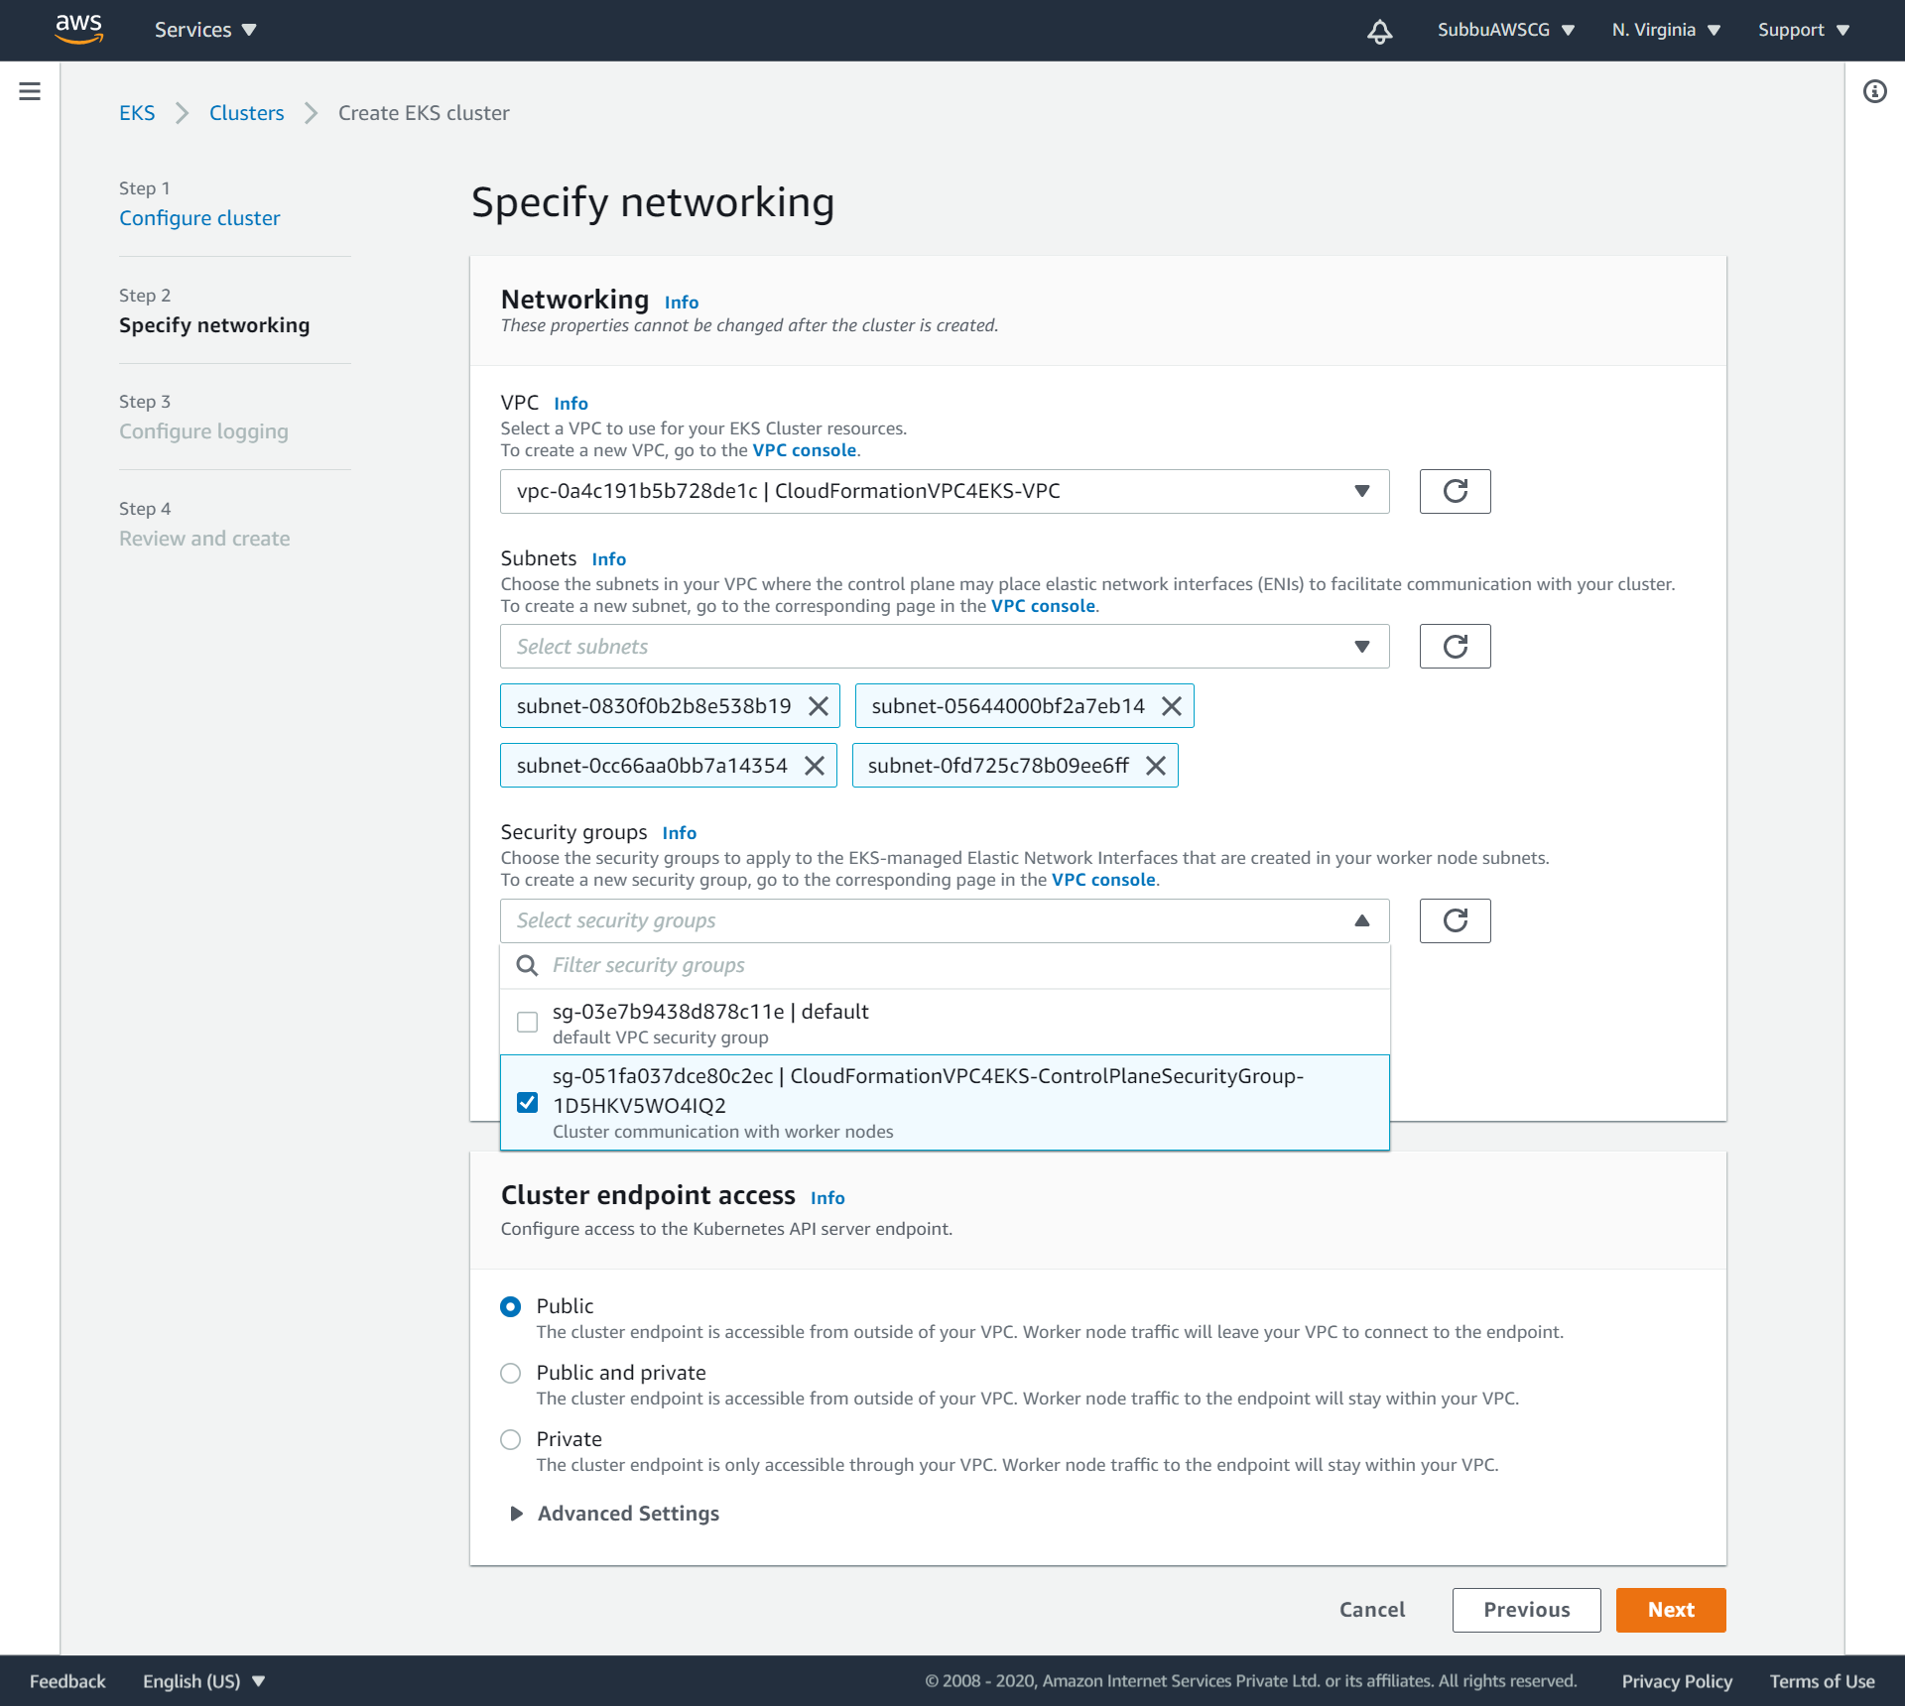
Choose the VPC, Subnet’s and Security-Group’s that we created:

Slide 41
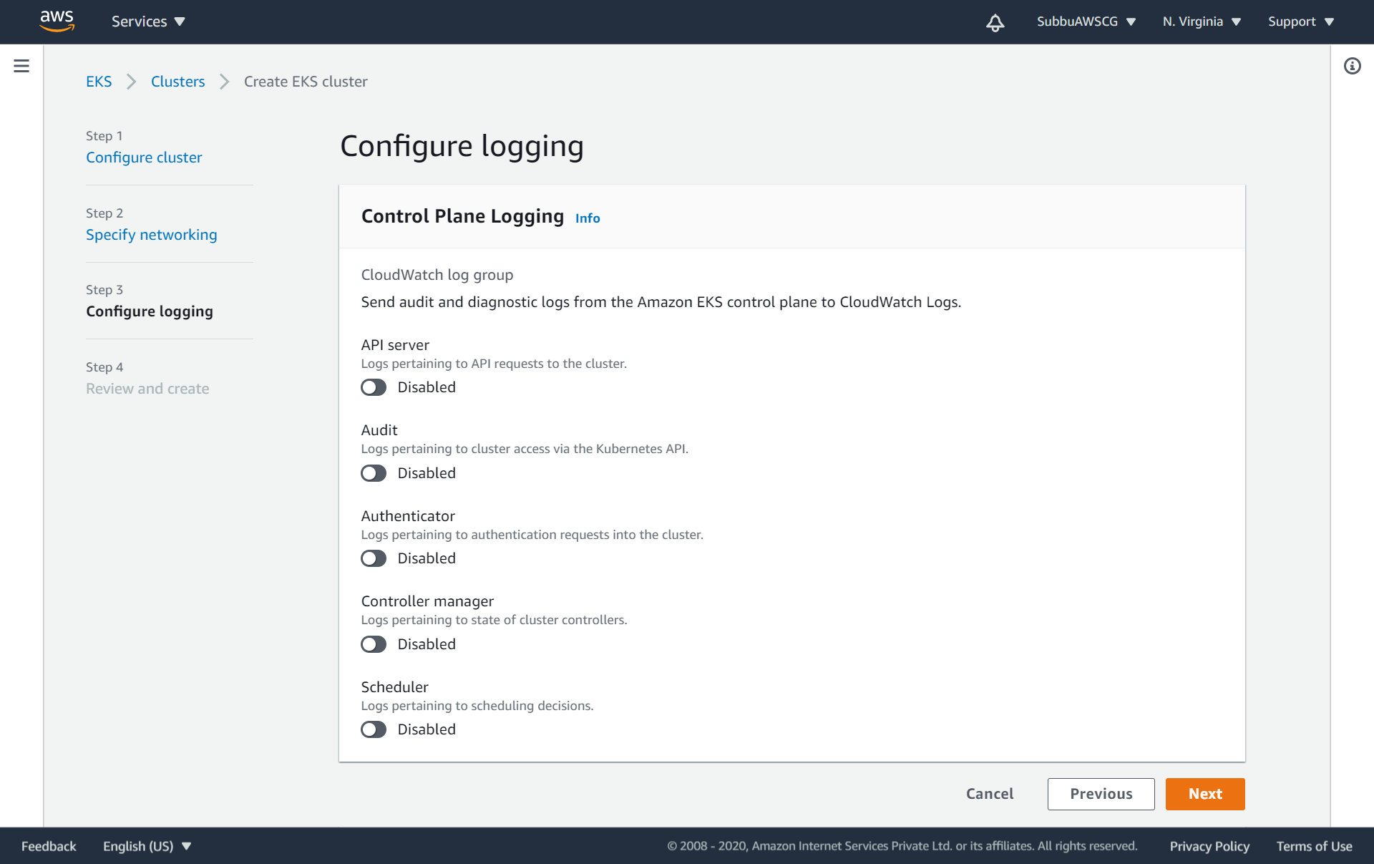
Configure Log’s if needed:

Slide 42
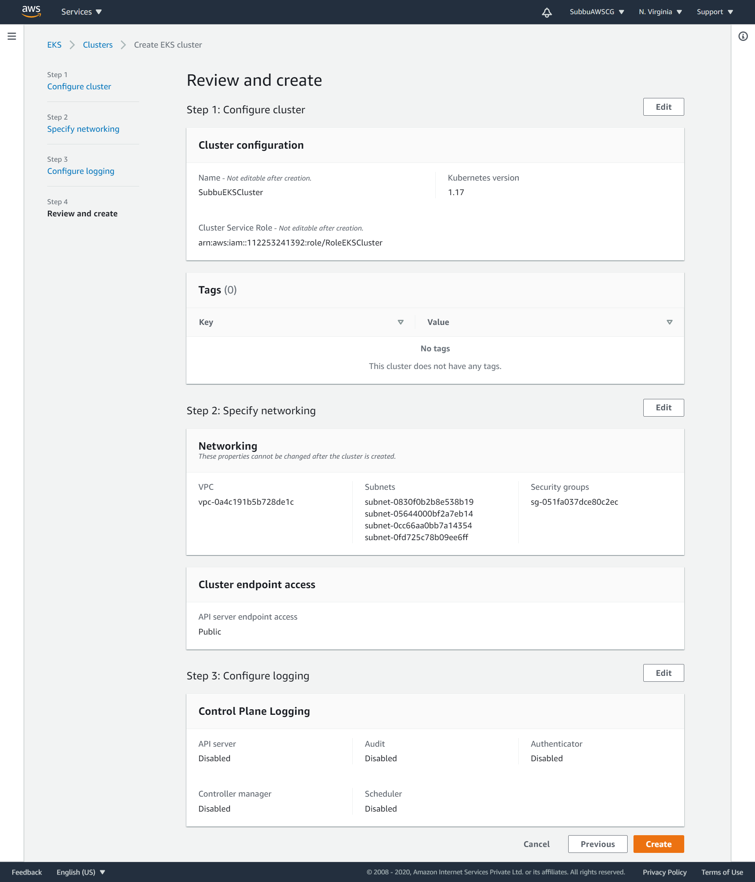
Review and Create EKS:

Slide 43
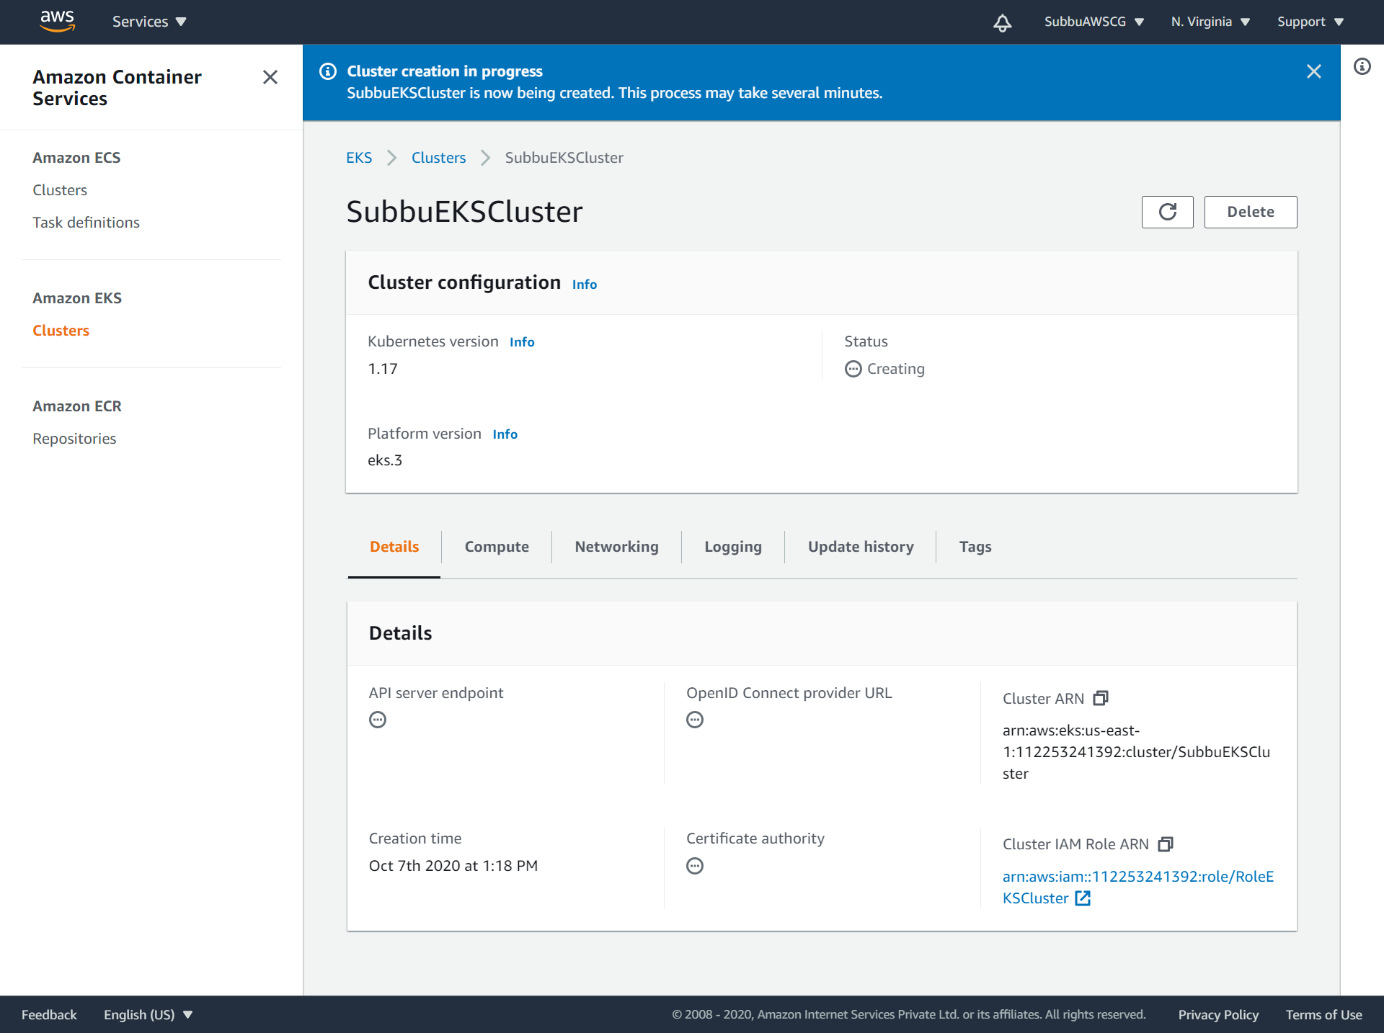
Cluster creation is in Progress:

Slide 44
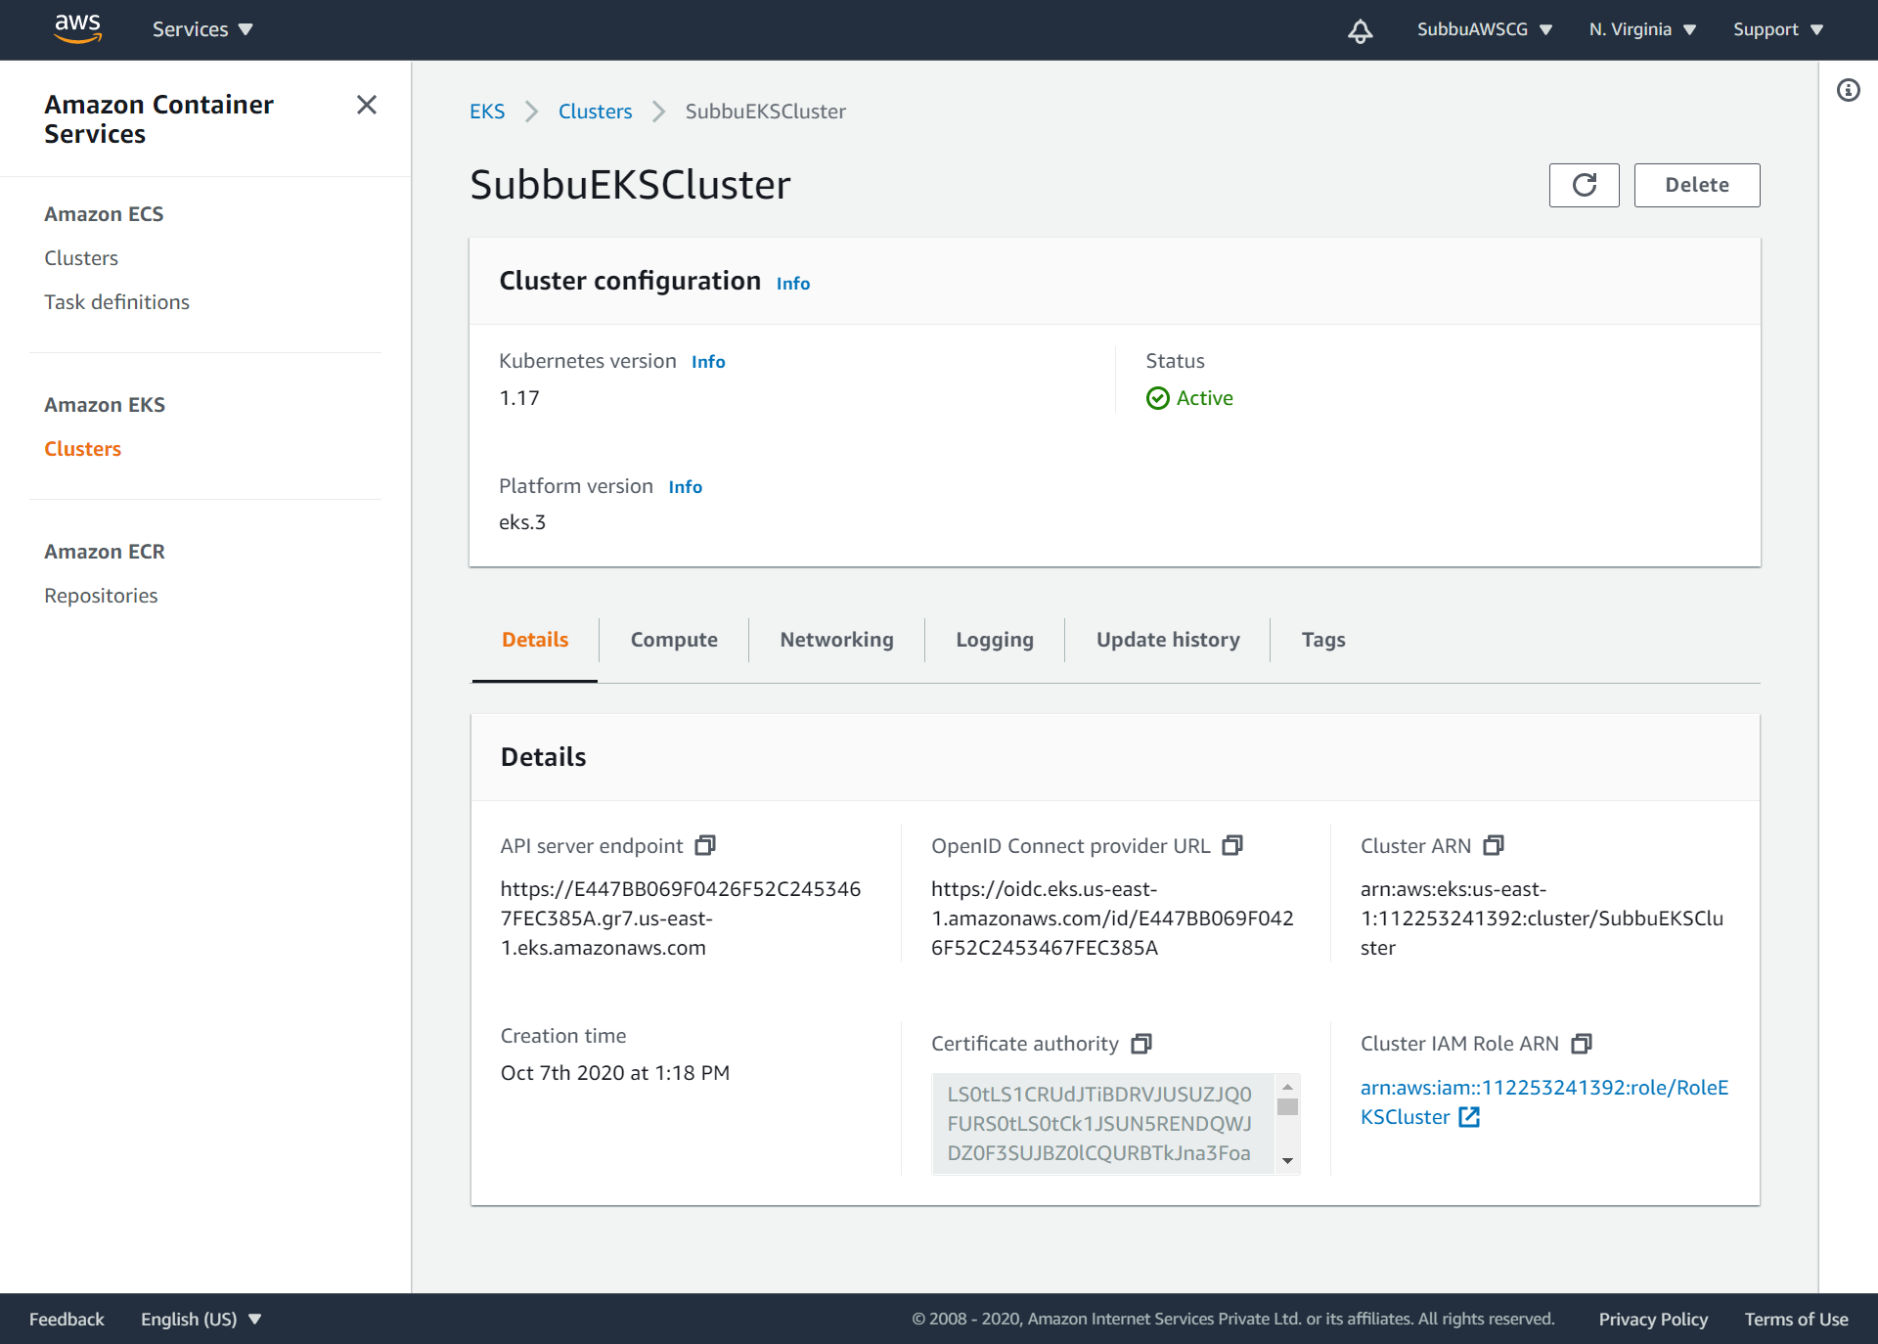
Now the EKS Cluster is Active - Details:

Slide 45
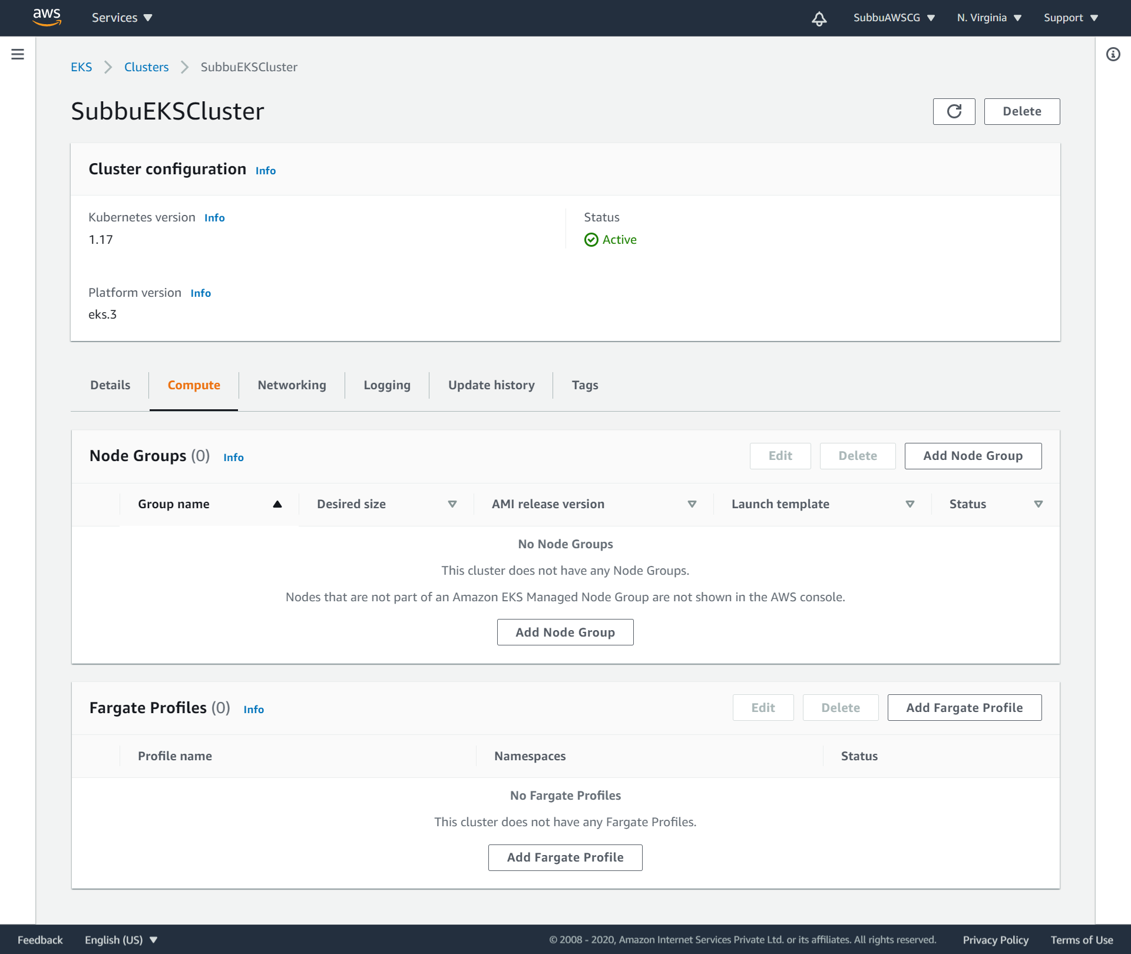
EKS Cluster – Compute Details:

Slide 46
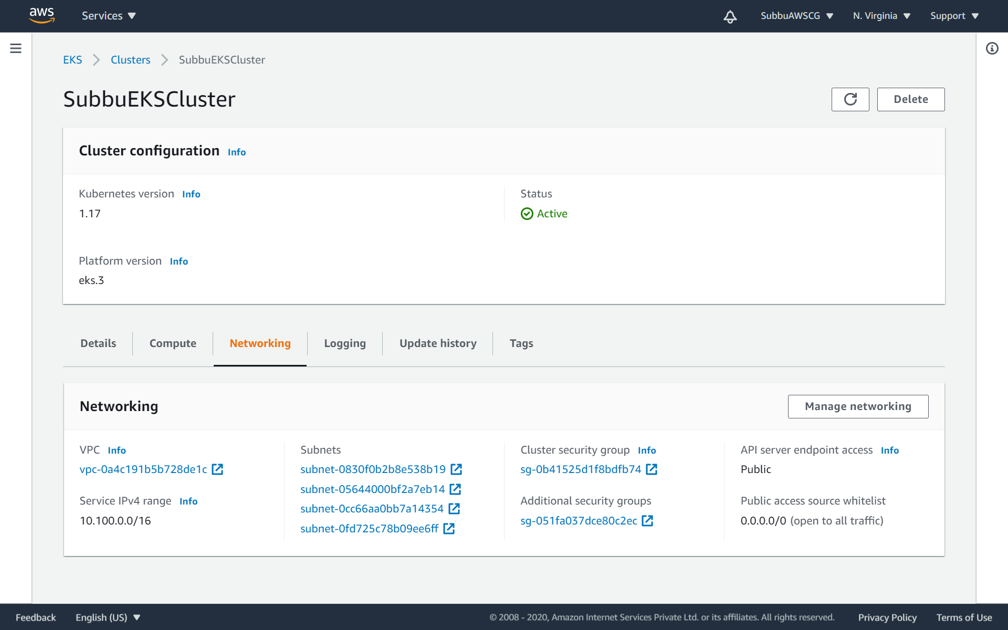
EKS Cluster – Networking Details:

Slide 47
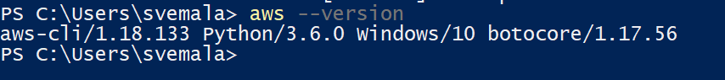
Check for the correct installation of AWS CLI: Command: aws --version

Slide 48
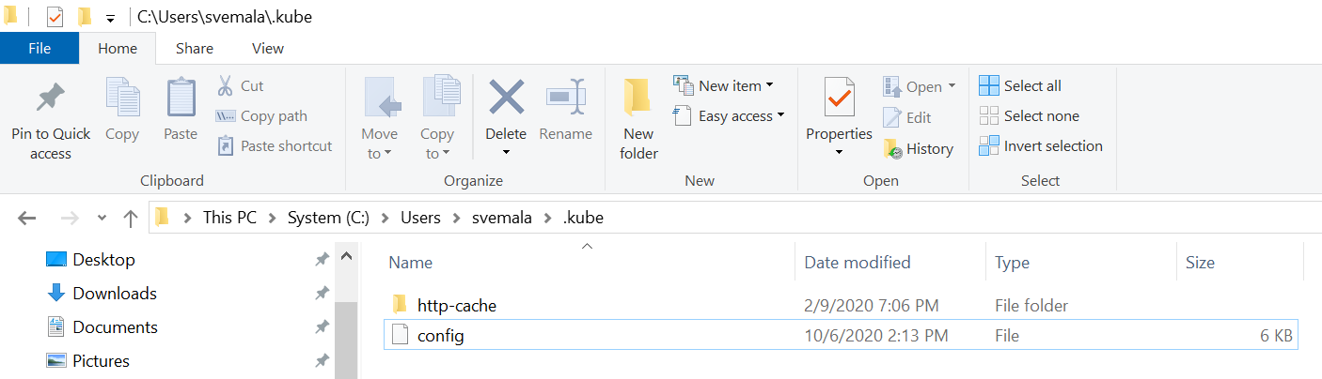
Kube config file, after the installation of Kubectl:

Slide 49
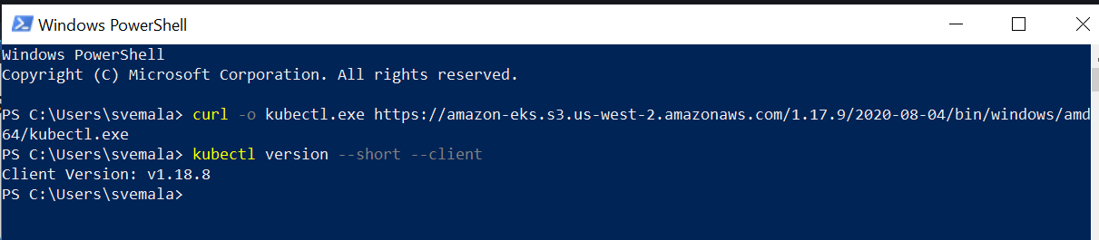
# Installing Kubectl and check its version:

Slide 50
Commands and the details:
PS C:\Users\svemala> curl -o kubectl.exe https://amazon-eks.s3.us-west-2.amazonaws.com/1.17.9/2020-08-04/bin/windows/amd
64/kubectl.exe
PS C:\Users\svemala> kubectl version --short --client
Client Version: v1.18.8
PS C:\Users\svemala>

Slide 51
# Installing eksctl (Need to be used to configure the EKS through CLI): Open PowerShell as Administrator and run.
Set-ExecutionPolicy Bypass -Scope Process -Force; [System.Net.ServicePointManager]::SecurityProtocol = [System.Net.ServicePointManager]::SecurityProtocol -bor 3072; iex ((New-Object System.Net.WebClient).DownloadString('https://chocolatey.org/install.ps1'))

Slide 52
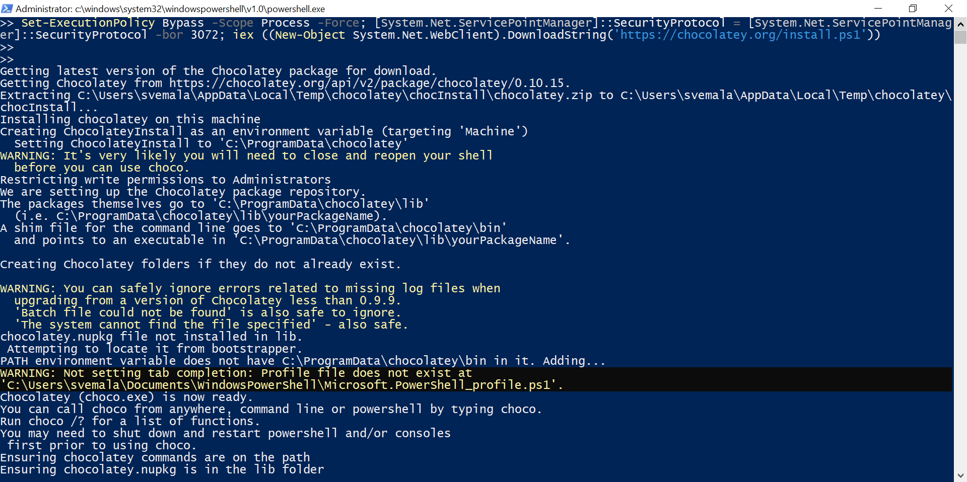
Install Chocolatey : Set-ExecutionPolicy Bypass -Scope Process -Force; [System.Net.ServicePointManager]::SecurityProtocol = [System.Net.ServicePointManager]::SecurityProtocol -bor 3072; iex ((New-Object System.Net.WebClient).DownloadString('https://chocolatey.org/install.ps1'))

Slide 53
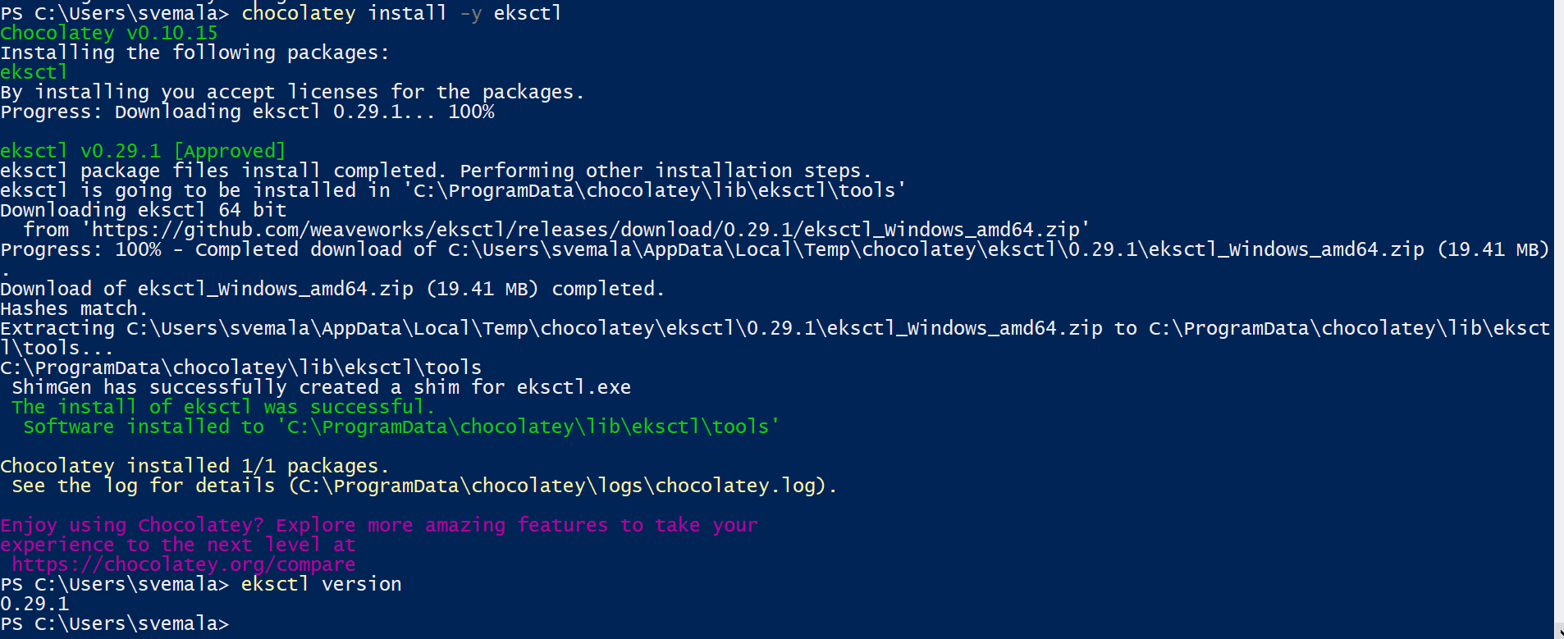
Eksctl is installed: Command: chocolatey install -y eksctl Command: eksctl version

Slide 54
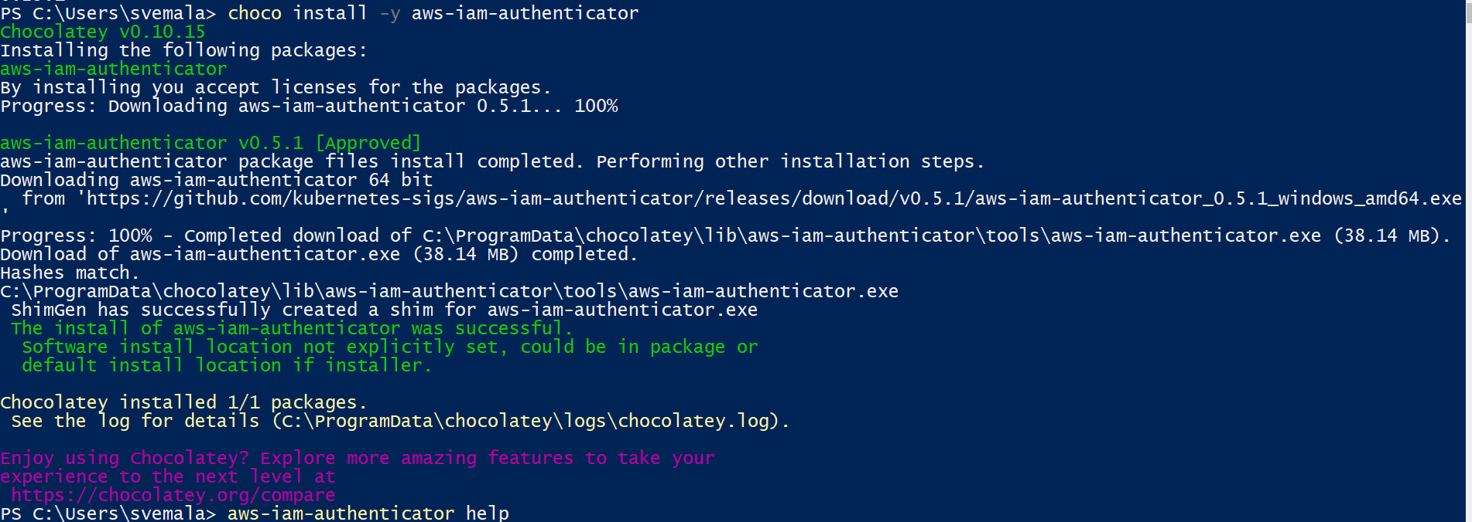
# Installing aws-iam-authenticator: To install aws-iam-authenticator on Windows with Chocolatey. Command: choco install -y aws-iam-authenticator

Slide 55

Test the successful installation of aws-iam-authenticator: Command: aws-iam-authenticator help

Slide 56
Add created AWS Cluster to the Kubectl config file: Command: aws eks update-kubeconfig --name SubbuEKSCluster

Slide 57

Kubectl Config file is updated with our cluster:

Slide 58

# Create Worker nodes: By using the CloudFormation template from the below S3 location. https://amazon-eks.s3.us-west-2.amazonaws.com/cloudformation/2020-08-12/amazon-eks-nodegroup.yaml

Slide 59

Provide the necessary Auto scaling and other configuration details for the Worker nodes:

Slide 60

Review the Worker nodes details:

Slide 61

Worker nodes create is in progress:

Slide 62

Worker nodes created:

Slide 63

CloudFormation stacks created for both VPC and for the Worker nodes:

Slide 64

Check for the created nodes through the Kubectl: Command: kubectl get nodes No nodes found, because we need to map the Worker nodes with the EKS Cluster.

Slide 65

Worker nodes – ‘Outputs’ tab view:

Slide 66

Auto Scaling group created for the Worker nodes:

Slide 67

# Map Worker nodes with Ekscluster, by giving the ARN of the worker nodes as below in the configmap file: (Scripts are in my GitHub repository https://github.com/subbugh/aws-eks )

Slide 68

Map the Worker nodes, with the EKS Cluster: Command: kubectl apply -f wnode-ekscluster-configmap.yaml Command: kubectl get nodes

Slide 69

The EC’s created as a part of Worker Nodes as per the Config defined in the yaml file:

Slide 70
# Deploy a sample nginx application:

Slide 71

Create a sample application: Use the sample yaml deployment file from the github.

Slide 72

Check for the POD’s created: Command: kubectl get all -n my-namespace

Slide 73

View the details of the deployed service: Command: kubectl -n my-namespace describe service my-service

Slide 74

View the details of one of the pods that was deployed: Command: kubectl -n my-namespace describe pod my-deployment-65dcf7d447-6b5xh

Slide 75

Continued - More details of the POD ‘my-deployment-65dcf7d447-6b5xh’:

Slide 76
Enter into any of the POD’s: Command: kubectl exec -it my-deployment-65dcf7d447-6b5xh -n my-namespace -- /bin/bash

Slide 77

View the DNS resolver configuration file: Command: cat /etc/resolv.conf

Slide 78

Remove the sample service, deployment, pods, and namespace: Command: kubectl delete namespace my-namespace

Slide 79

Delete the Cluster view on the AWS console:

Slide 80

Delete Auto Scaling group for the Worker nodes:

Slide 81

Release the EIP’s created along with VPC:

Slide 82

EIP’s released:

Slide 83
Refer to my GitHub repo, for the script files and other details:
https://github.com/subbugh/aws-eks

Slide 84
Appendix: URL’s and some more Slides, for more information.
https://github.com/subbugh/aws-eks
https://docs.aws.amazon.com/eks/index.html
https://aws.amazon.com/getting-started/hands-on/deploy-kubernetes-app-amazon-eks/
https://docs.aws.amazon.com/eks/latest/userguide/install-kubectl.html
https://chocolatey.org/install
https://docs.aws.amazon.com/eks/latest/userguide/eksctl.html
https://docs.aws.amazon.com/eks/latest/userguide/create-public-private-vpc.html
https://docs.aws.amazon.com/eks/latest/userguide/install-aws-iam-authenticator.html
https://docs.aws.amazon.com/eks/latest/userguide/launch-workers.html
https://docs.aws.amazon.com/eks/latest/userguide/sample-deployment.html
https://kubernetes.io/docs/reference/kubectl/cheatsheet/
https://kubernetes.io/docs/tasks/access-application-cluster/list-all-running-container-images/
http://docs.aws.amazon.com/autoscaling/latest/userguide/as-process-shutdown.html
https://docs.aws.amazon.com/eks/latest/userguide/delete-cluster.html
https://kubernetes.io/docs/tasks/run-application/run-stateless-application-deployment/#scaling-the-application-by-increasing-the-replica-count

